Slide 1
Power & Surveillance
SAE Creative Institute, Perth, Western Australia
5th July 2019

Slide 2
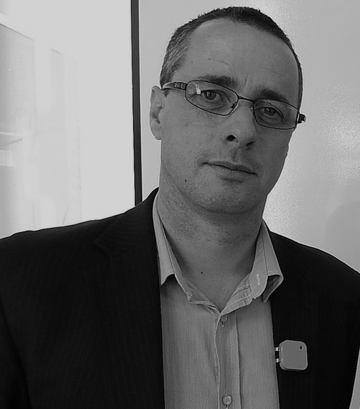
ALEXANDER HAYES
PhD candidate University of Wollongong, Sydney Australia Visiting Researcher Aalto University, Helsinki, Finland

Slide 3
Acknowledgement of Country
Alexander Hayes acknowledges that this presentation occurred on the Country of the Whadjuk People of the Noongar / Nyungar Nation in Perth, Western Australia. Alexander wishes to acknowledge past, present and future leaders of the Whadjuk People and respect their continuing culture and the contribution they make to the life of this city and this region.

Slide 4
CONSENT
THIS PRESENTATION IS BEING RECORDED AND ALL OF YOUR AUDIO INTERACTIONS WILL BE CAPTURED VIA THE INVITED SPEAKERS MICROPHONE. IF YOU DO NOT WISH TO BE VISUALLY RECORDED ON CAMERA PLEASE DO NOT PASS BETWEEN THE INVITED SPEAKER AND THE EXIT DOOR, NOR ARE YOU REQUIRED TO INTERACT AUDIBLY WITH THE INVITED SPEAKER. THE ENTIRE PRESENTATION BETWEEN COMMENCEMENT AND CESSATION OF THIS SLIDE PRESENTATION WILL BE RECORDED, EDITED AND BROADCAST ONLINE AS A DIGITAL PRESENTATION ON THE INVITED SPEAKERS YOUTUBE CHANNEL VIA THE INTERNET. YOUR SUBJECT RIGHTS AND PRIVACY ARE IMPORTANT. THE INVITED SPEAKER INVITES YOU TO DISCUSS THIS TOPIC FURTHER AT A TIME AND PLACE WHICH RESPECTS BOTH PARTIES PERSONAL, COMMUNITY, NATIONAL AND GLOBAL HUMAN RIGHTS.

Slide 5
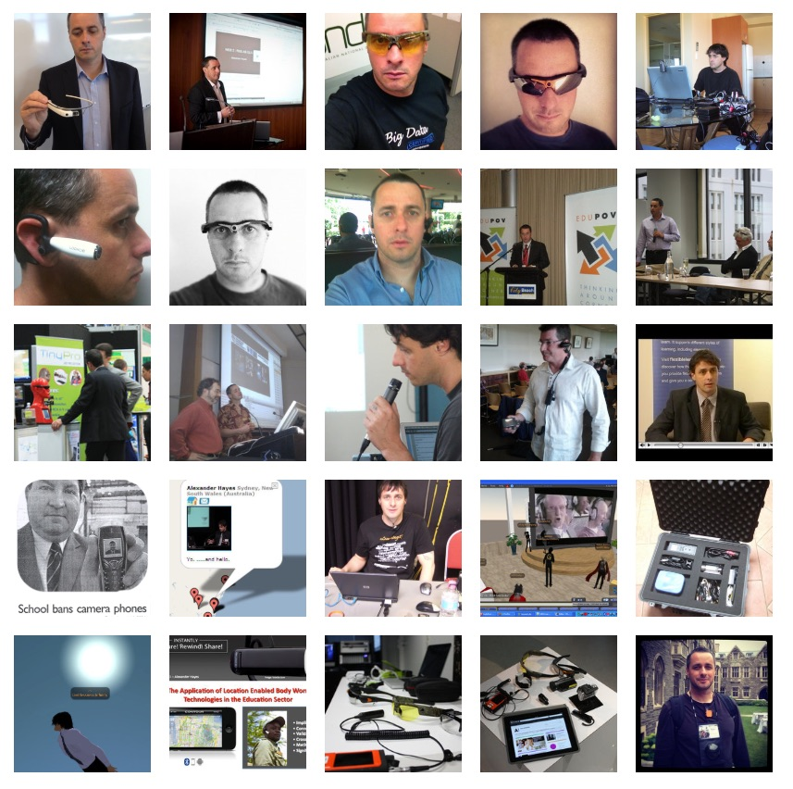
‘The Socioethical Implications of Body Worn Computers: An Ethnographic Study’
- 50 interviews with international leaders - engineering, policing, surveillance studies, national security, cyber-crimes, information systems, education and human computing industry.
privacy, security, society, implications, control, power, place, care, convenience, engineering, corporations, law, regulation, innovation, veillance, wearable computing

Slide 6
BENEFIT
DETRIMENT

Slide 7
HUMANITY

Slide 9
PARAMETER 1
PARAMETER 3
PARAMETER 2

Slide 10
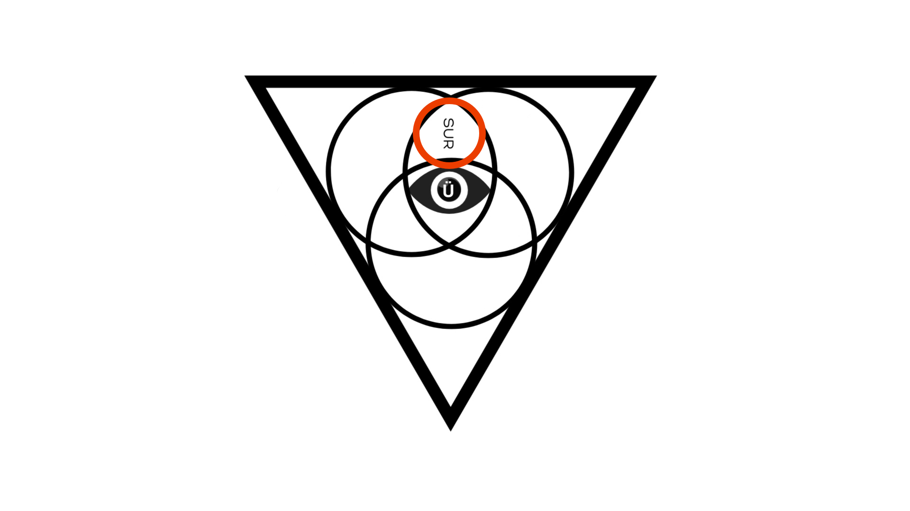
SURVEILLANCE

Slide 11
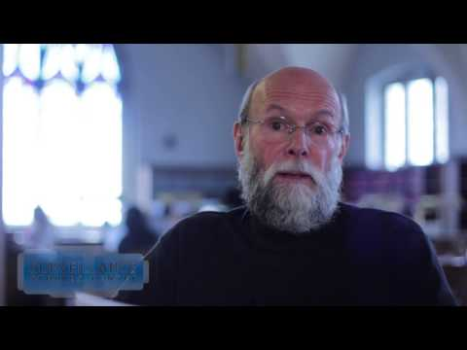
David Lyon - The Surveillance Studies Centre, Queen’s University, Canada

Slide 12
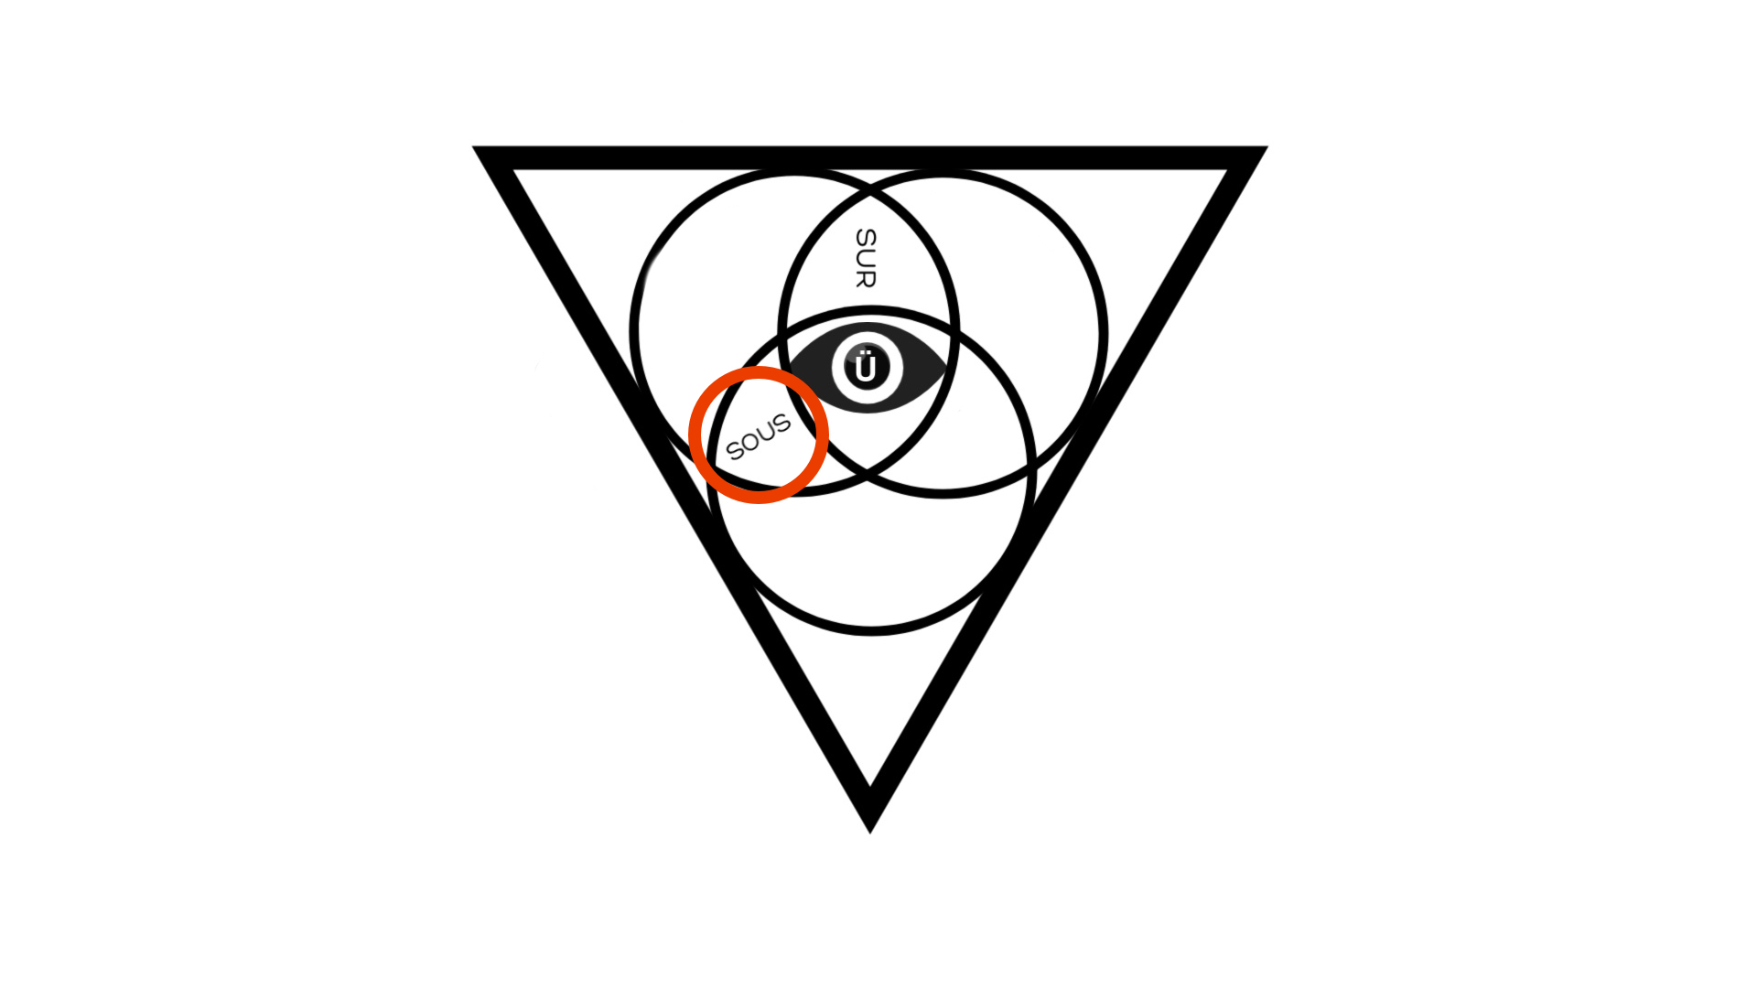
SURVEILLANCE
SOUSVEILLANCE

Slide 13
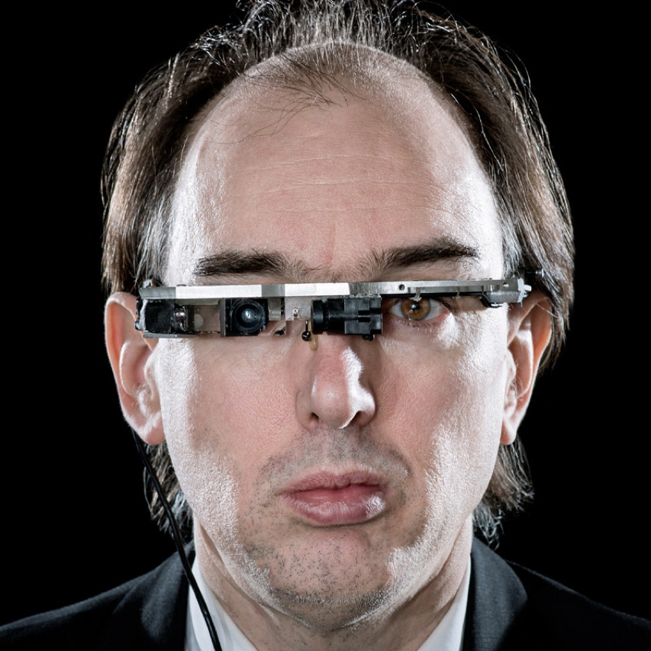
https://spectrum.ieee.org/geek-life/profiles/steve-mann-my-augmediated-life

Slide 14
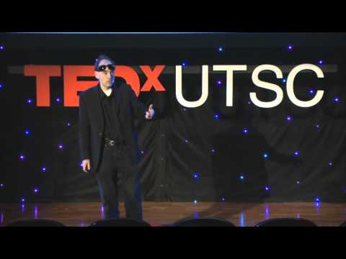
Steve Mann - ‘Father Of Wearable Computing’ TEDxUTSC

Slide 15
https://en.wikipedia.org/wiki/Gordon_Bell#/media/File:Gordon_Bell.jpg

Slide 17
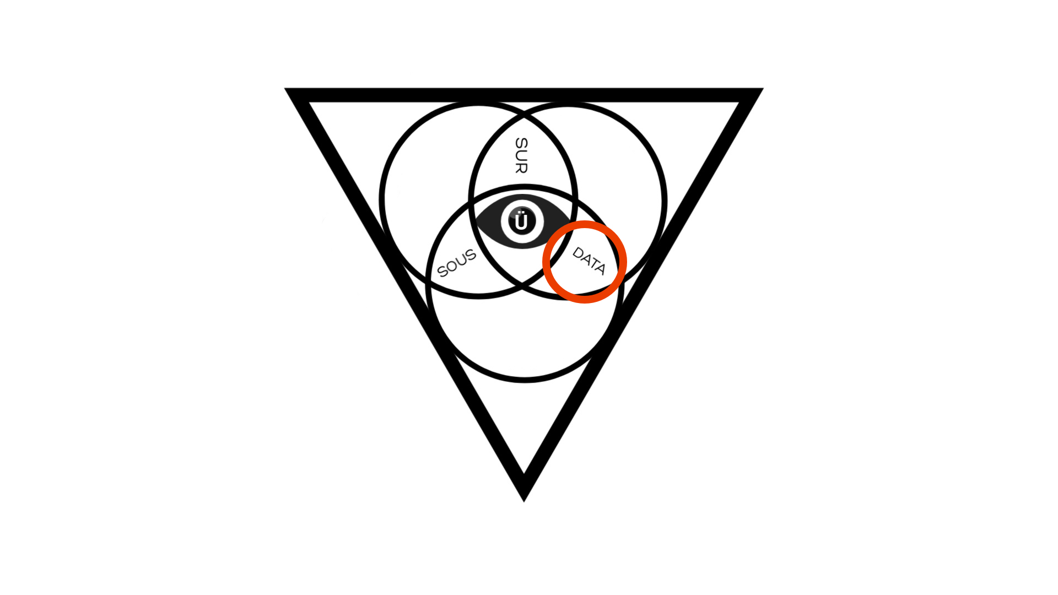
SURVEILLANCE
SOUSVEILLANCE
DATAVEILLANCE

Slide 18
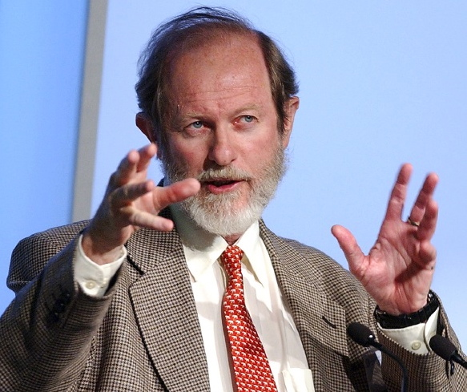
“... Dataveillance is the systematic creation and/or use of personal data for the investigation or monitoring of the actions or communications of one or more persons.”
Roger Clarke

Slide 20
“... Over the past three decades, Radio Frequency IDentification (RFID) systems have evolved to become cornerstones of many complex applications. From first beginnings, RFID has been promoted as an innovation in convenience and monitoring efficiencies.”
Masters, A. & Michael, K., 2005. Humancentric Applications of RFID Implants: The Usability Contexts of Control, Convenience and Care. In Second IEEE International Workshop on Mobile Commerce and Services. The Second IEEE International Workshop on Mobile Commerce and Services. IEEE, pp. 32–41. Available at: http://dx.doi.org/10.1109/WMCS.2005.11.
Katina Michael

Slide 21
UBERVEILLANCE
UBERVEILLANCE
UBERVEILLANCE

Slide 22
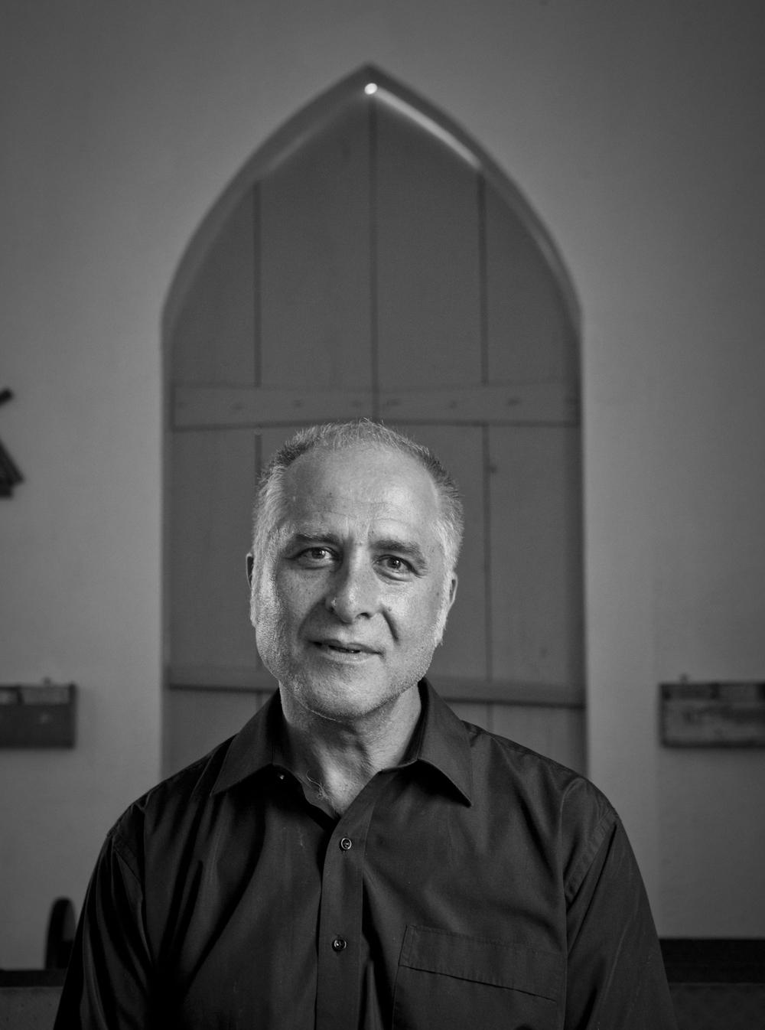
“... überveillance noun. an omnipresent electronic surveillance facilitated by technology that makes it possible to embed surveillance devices in the human body.”
M.G. Michael and K. Michael (2009). "Uberveillance: Definition" in ed. S. Butler, Fifth Edition of the Macquarie Dictionary (Australia's National Dictionary, Sydney University), p. 1094
M.G. Michael

Slide 23
Photo: https://bit.ly/2Xc6LjV

Slide 24
https://www.biohax.tech/

Slide 25
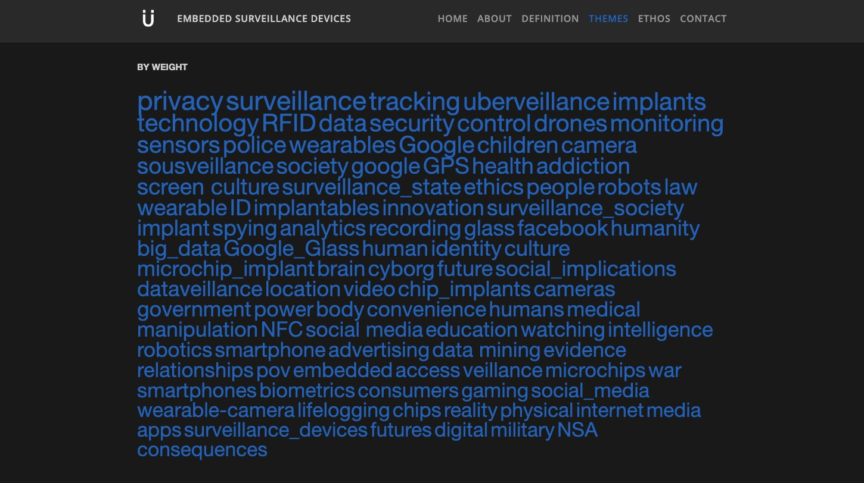

Slide 27
Case Study 1 ‘Right To Pass’
142 High Street, Fremantle Western Australia

Slide 28
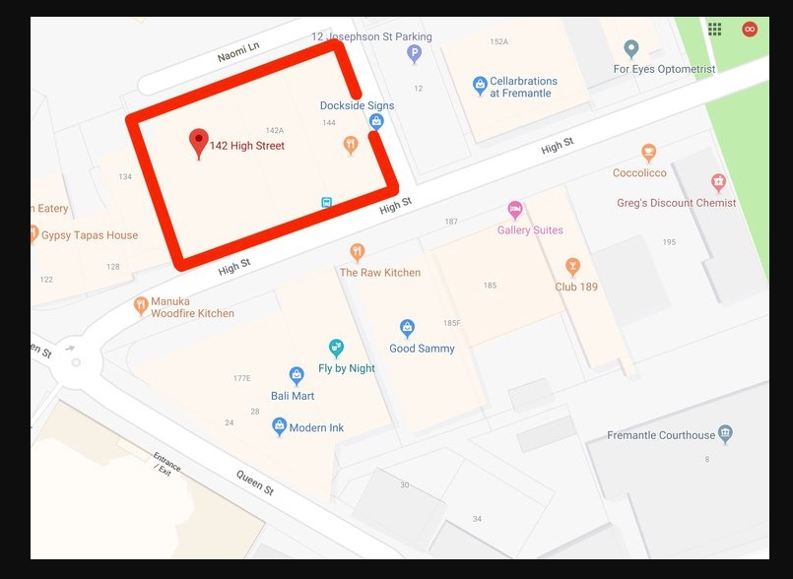
http://uberveillance.com/blog/142-high-street

Slide 29
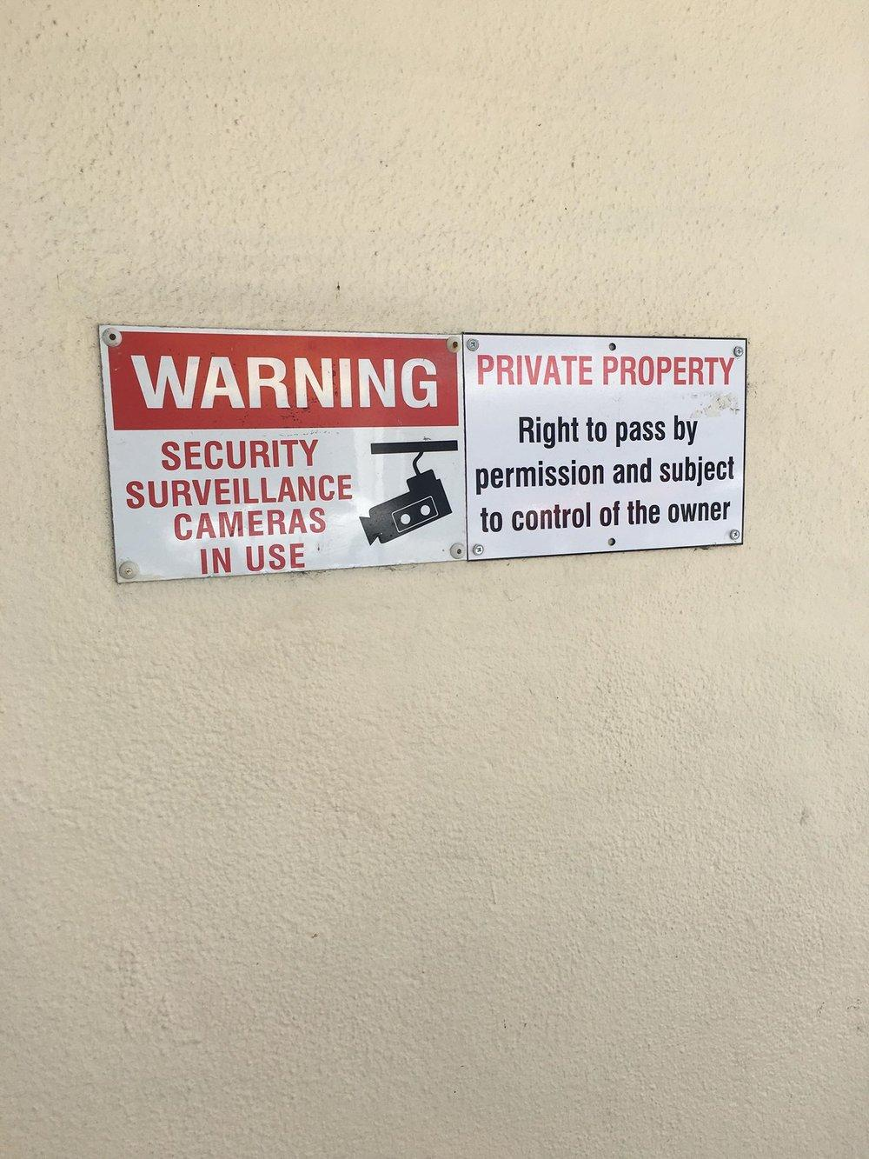
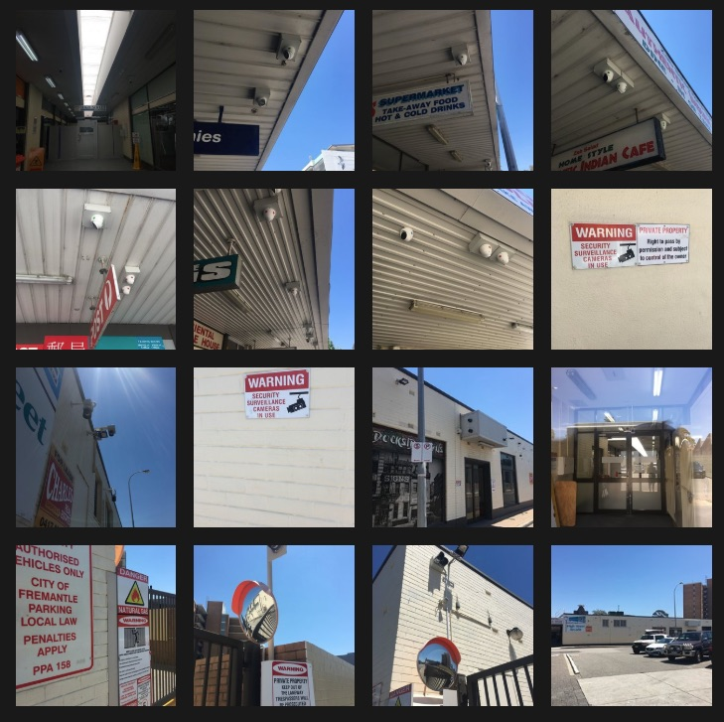
http://uberveillance.com/blog/142-high-street

Slide 30
Case Study 2 ‘Perth City Watch’
Perth, Western Australia

Slide 31
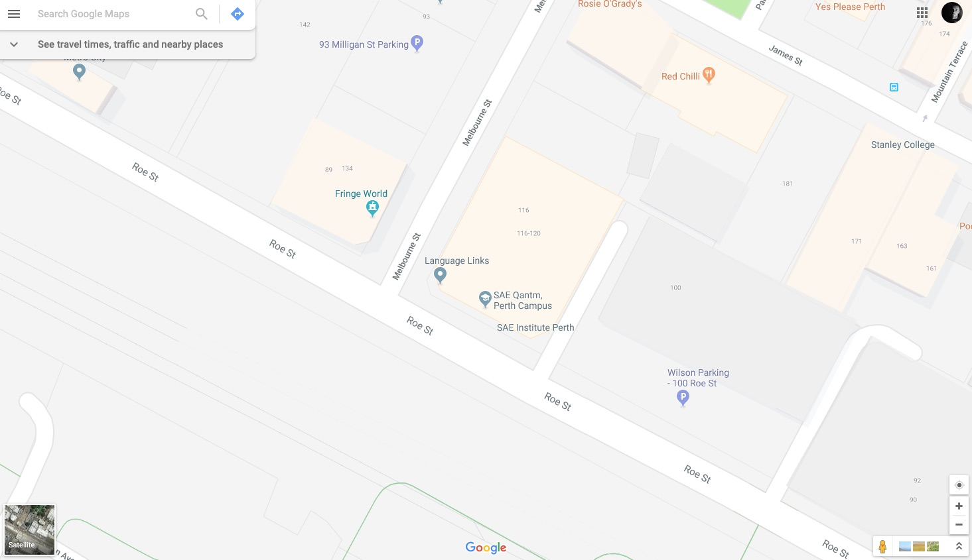

Slide 32
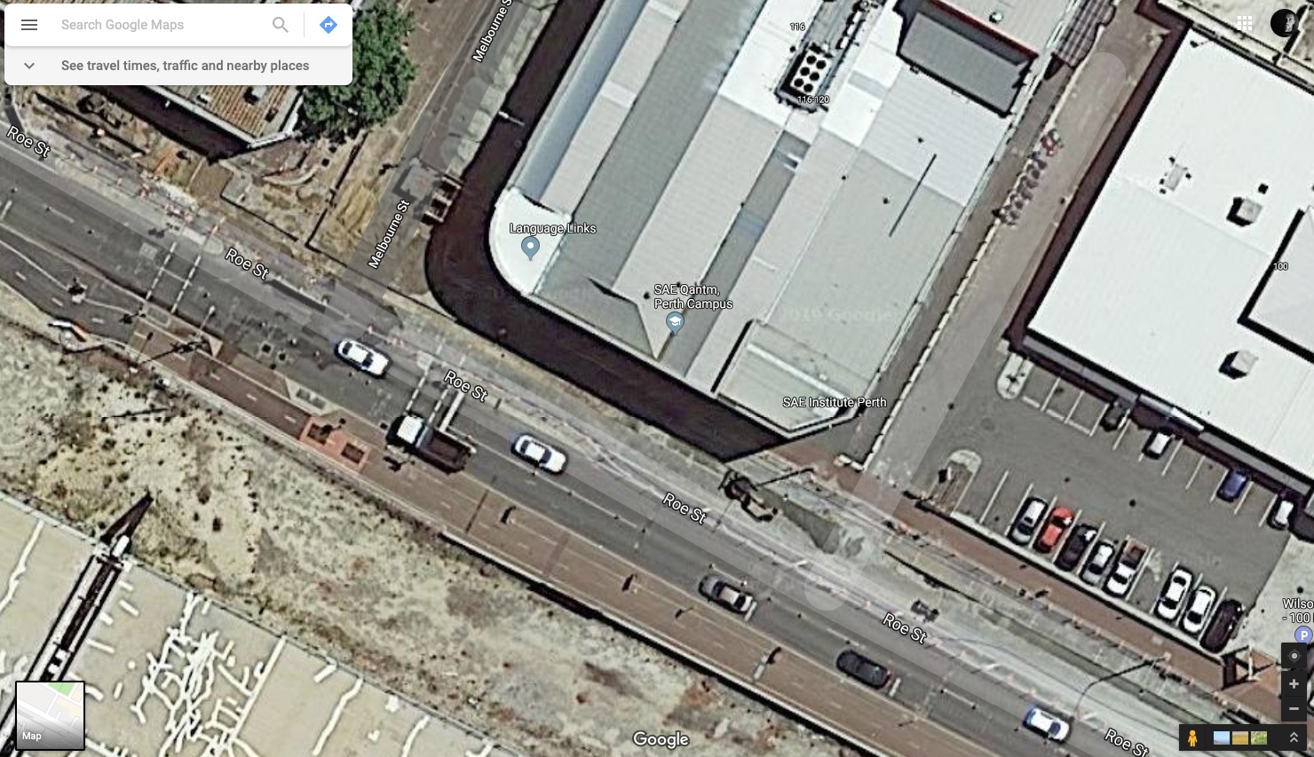

Slide 33
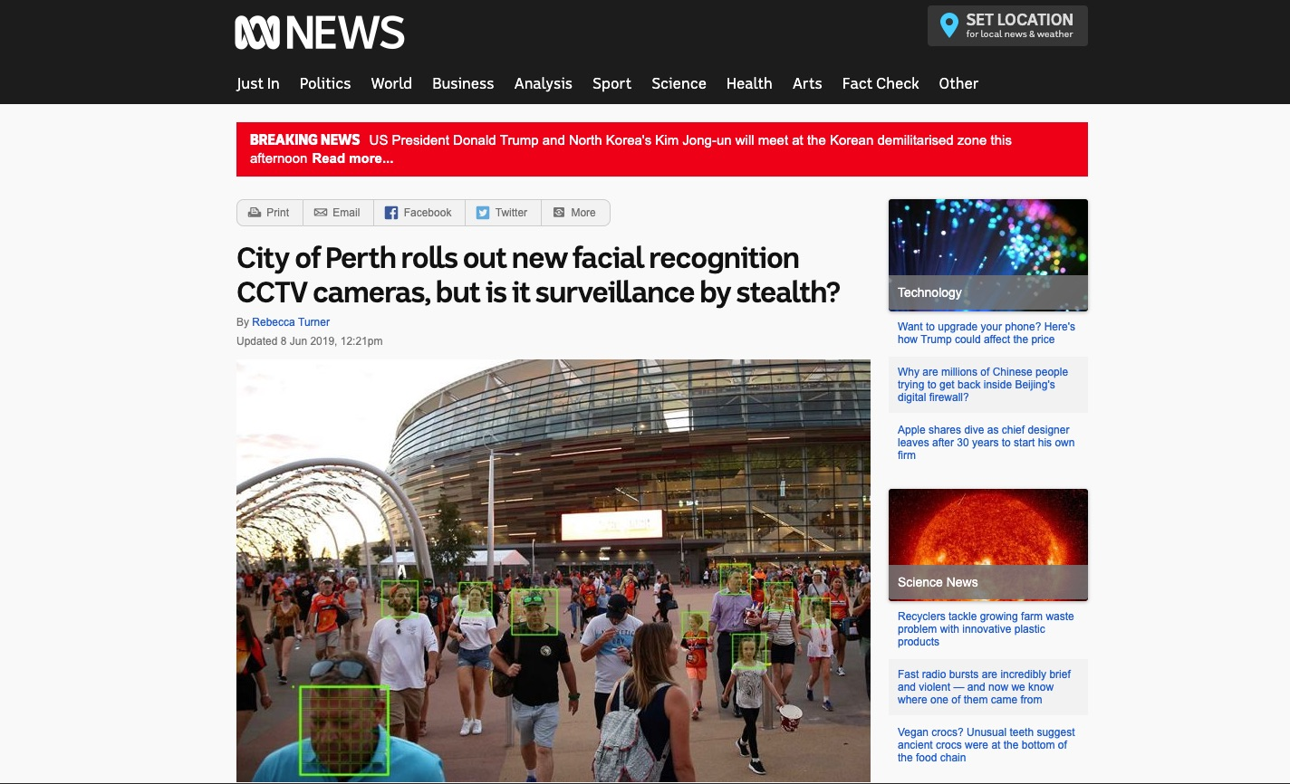
https://www.abc.net.au/news/2019-06-08/city-of-perth-rolls-out-new-facial-recognition-cctv-cameras/11147780

Slide 34
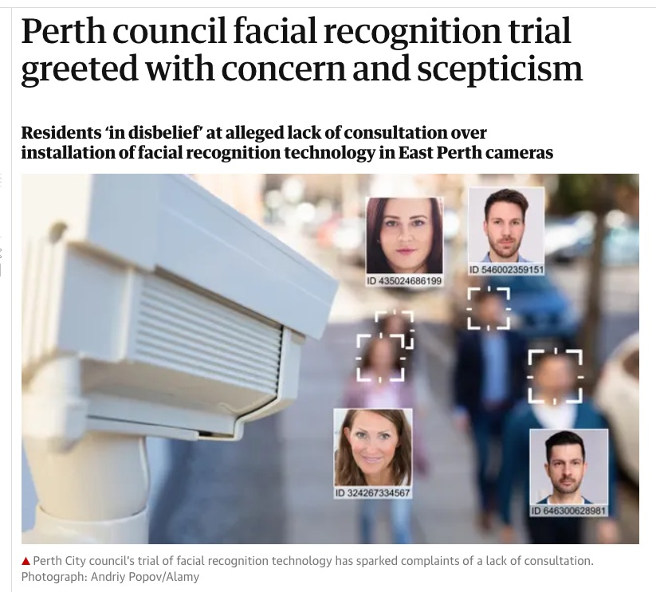

Slide 35
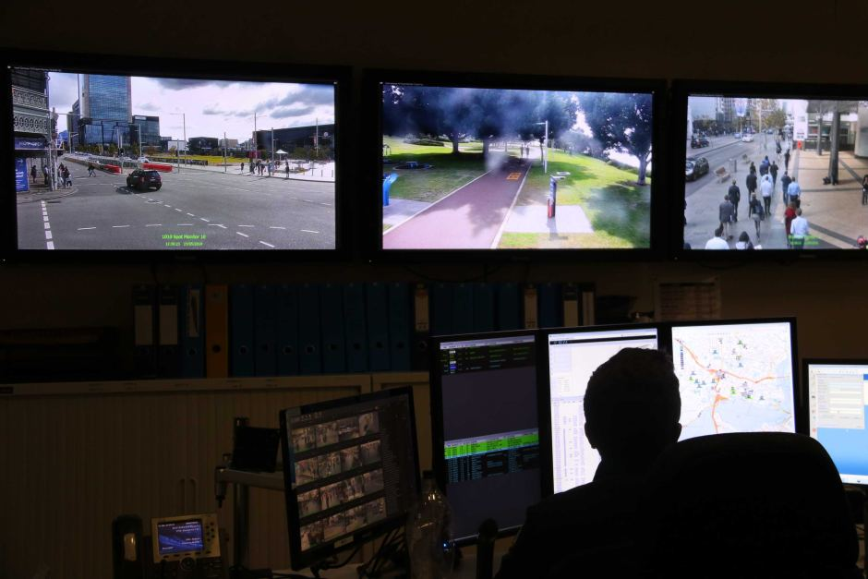
https://www.abc.net.au/news/2019-06-08/officer-monitors-citywatch-cctv-surveillance-cameras-1/11191026

Slide 36
Case Study 3 ‘Body Worn Cameras’
Perth, Western Australia

Slide 37
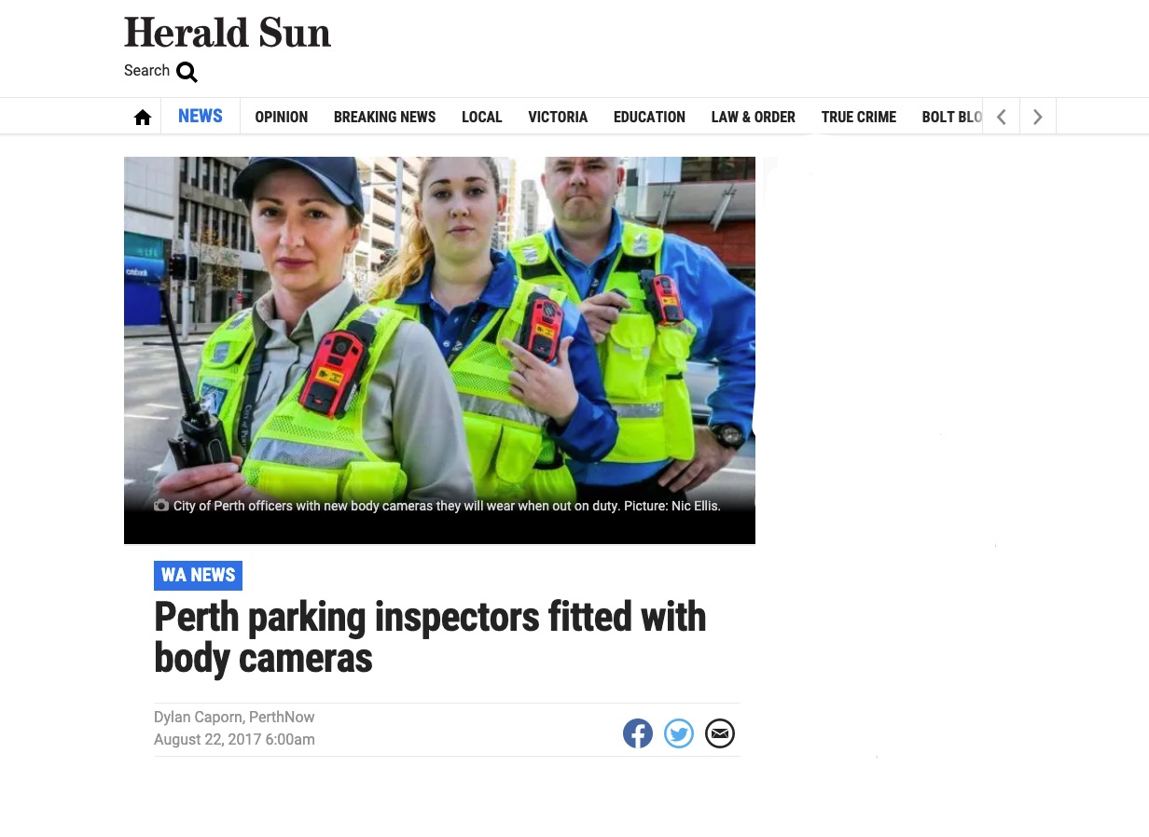

Slide 38
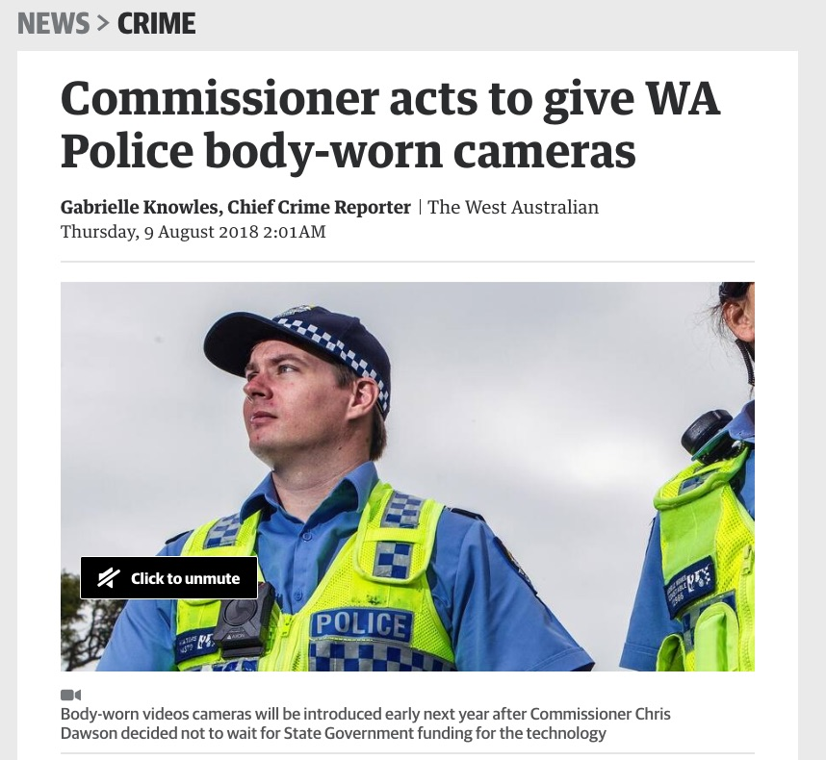

Slide 39
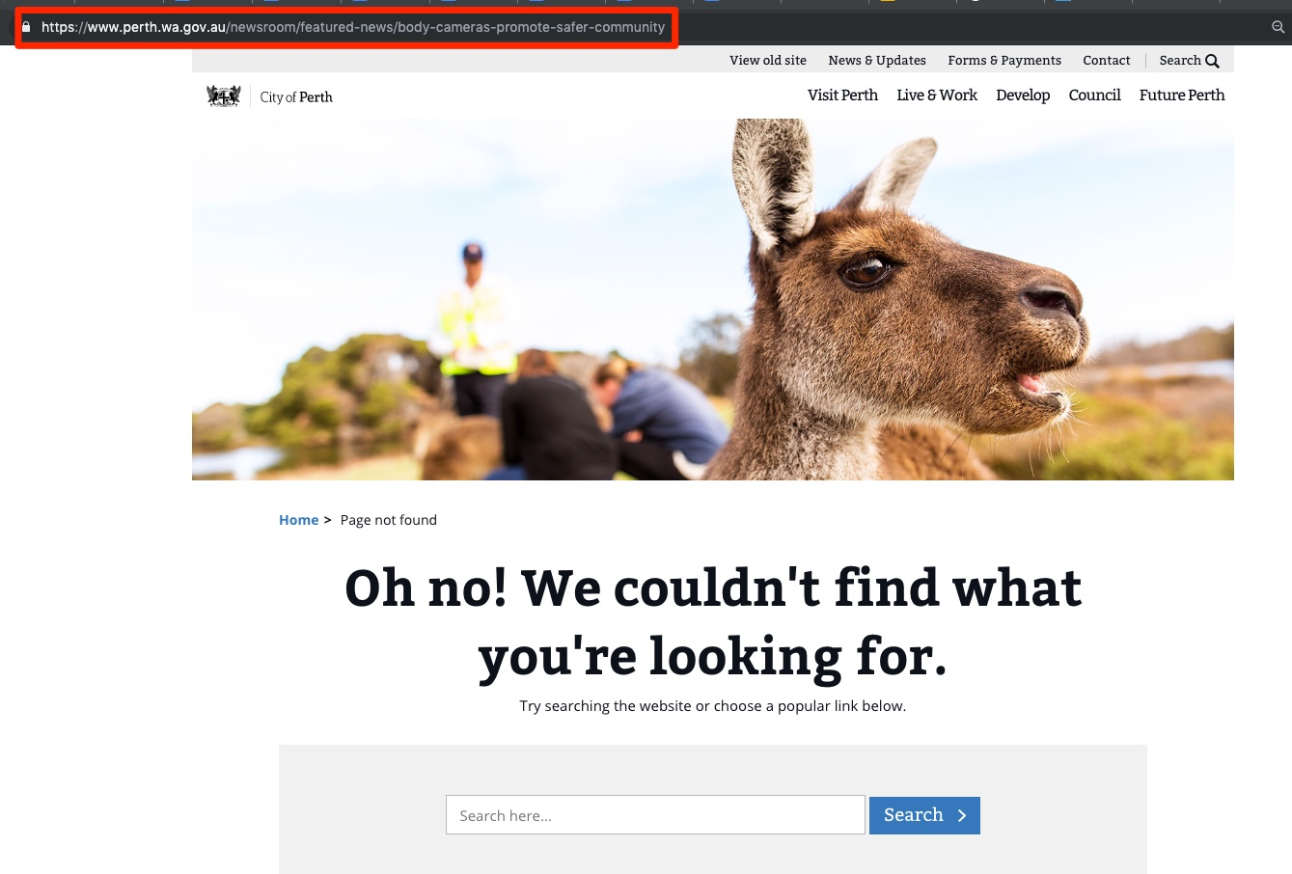

Slide 40
“... You began your query with a question about why there is little or no accessible information on the City of Perth website detailing the use, type, intent and governance of the Body Worn Camera technology currently being employed. We are not required to provide this information on our website for public access as the purpose of deploying the Body Worn Cameras is primarily for our staff safety in line with our responsibilities guided by the Occupational Health and Safety Act 1984.”
Email correspondence - Jan 14, 2019 - 1:45 PM - Kylie Taylor, Perth City Council, Business Operations Officer, Parking Services Unit

Slide 41
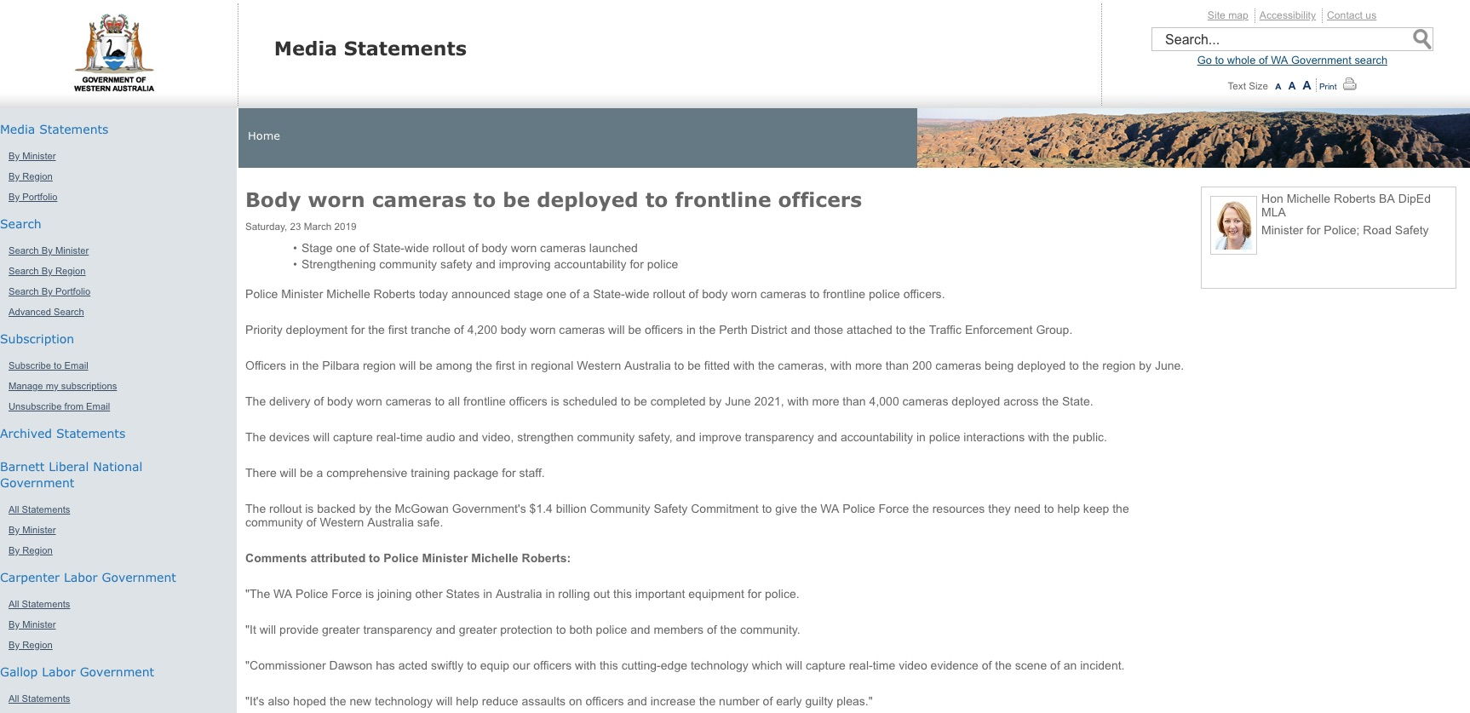

Slide 42
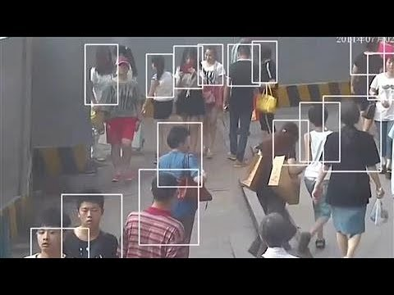
Life Inside China’s Total Surveillance State

Slide 43
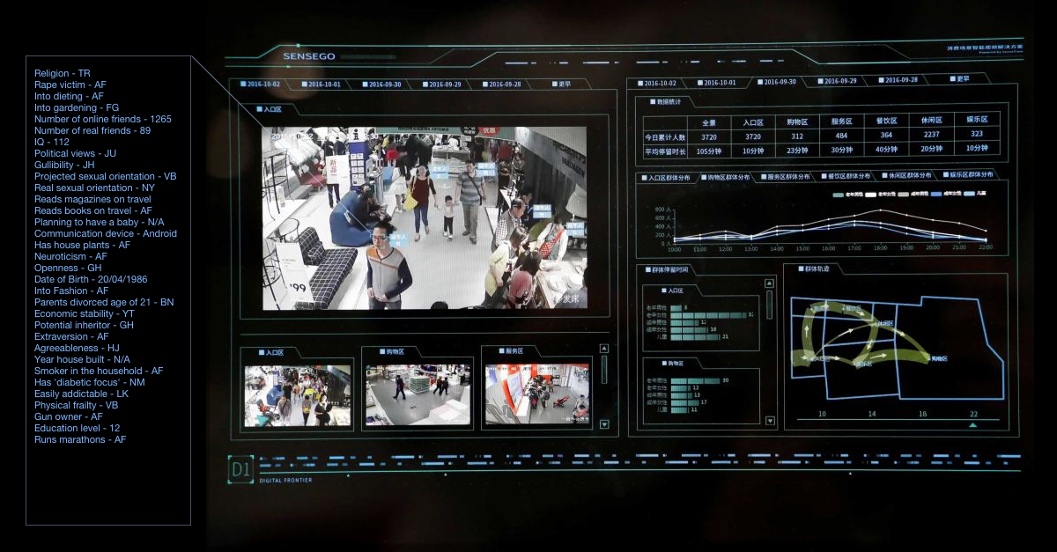

Slide 44
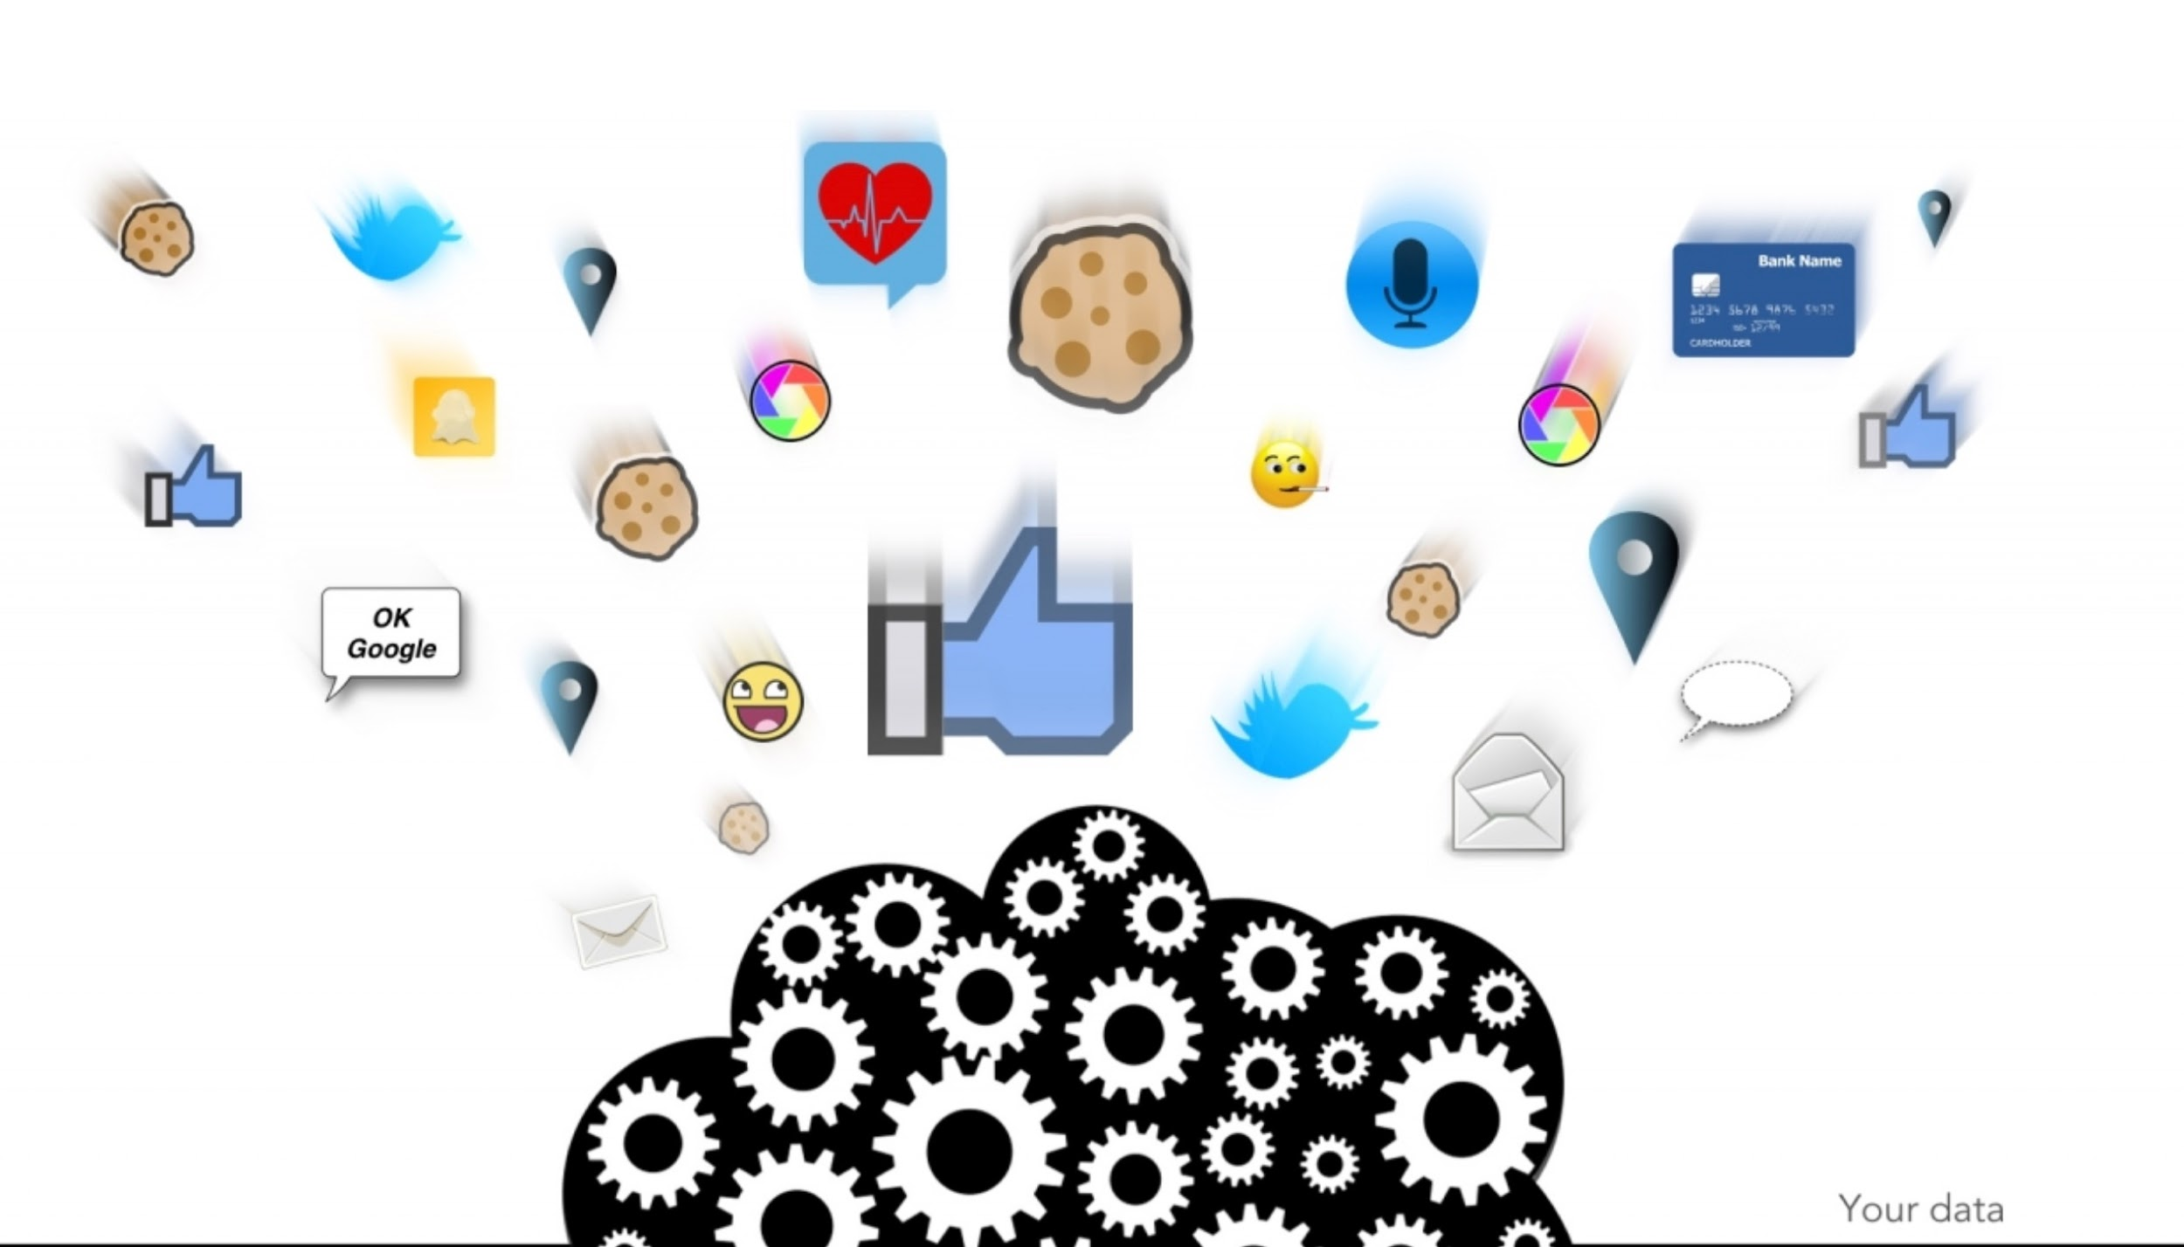
http://www.socialcooling.com

Slide 45
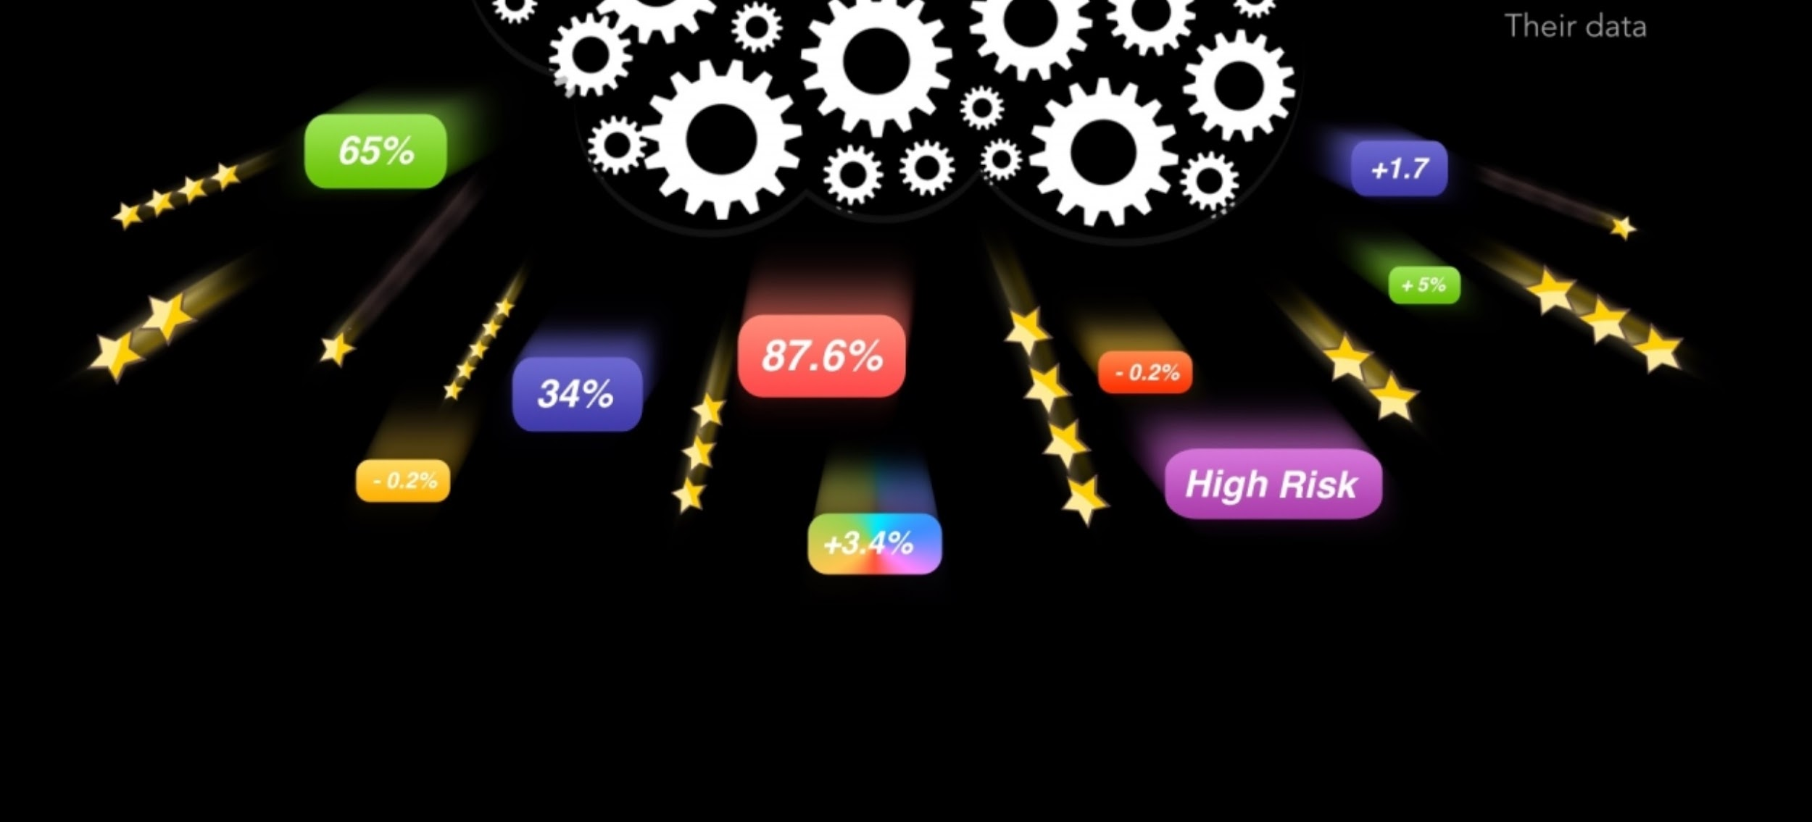
http://www.socialcooling.com

Slide 46
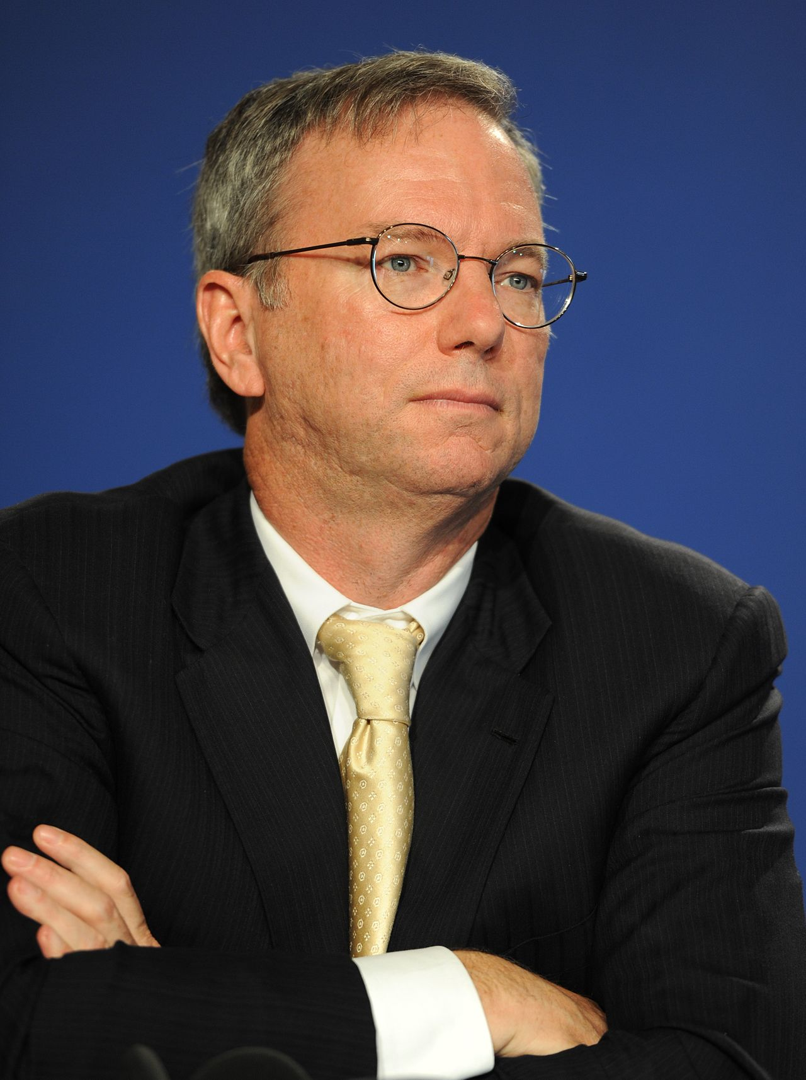
"... If you have something that you don't want anyone to know, maybe you shouldn't be doing it in the first place, but if you really need that kind of privacy, the reality is that search engines including Google do retain this information for some time, and it's important, for example that we are all subject in the United States to the Patriot Act. It is possible that that information could be made available to the authorities.”
Eric Schmidt - Former CEO, Google Inc.

Slide 47
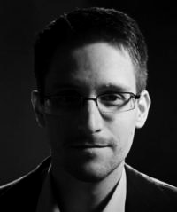
“... Arguing that you don't care about the right to privacy because you have nothing to hide is no different than saying you don't care about free speech because you have nothing to say."
Edward Snowden

Slide 50
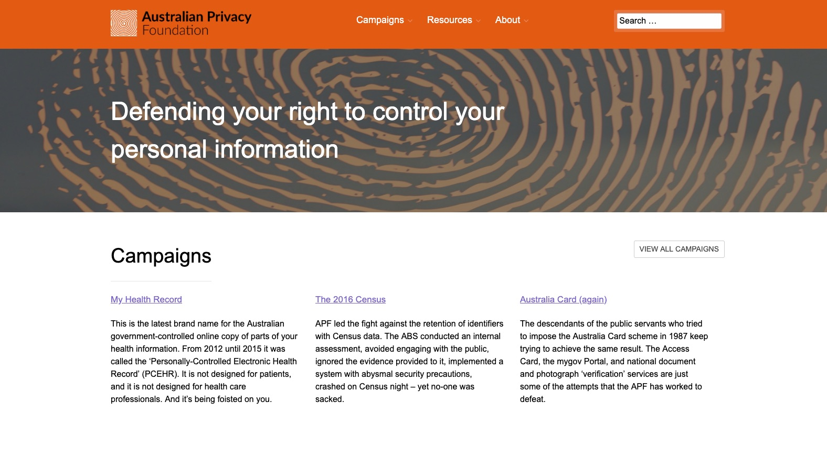

Slide 51
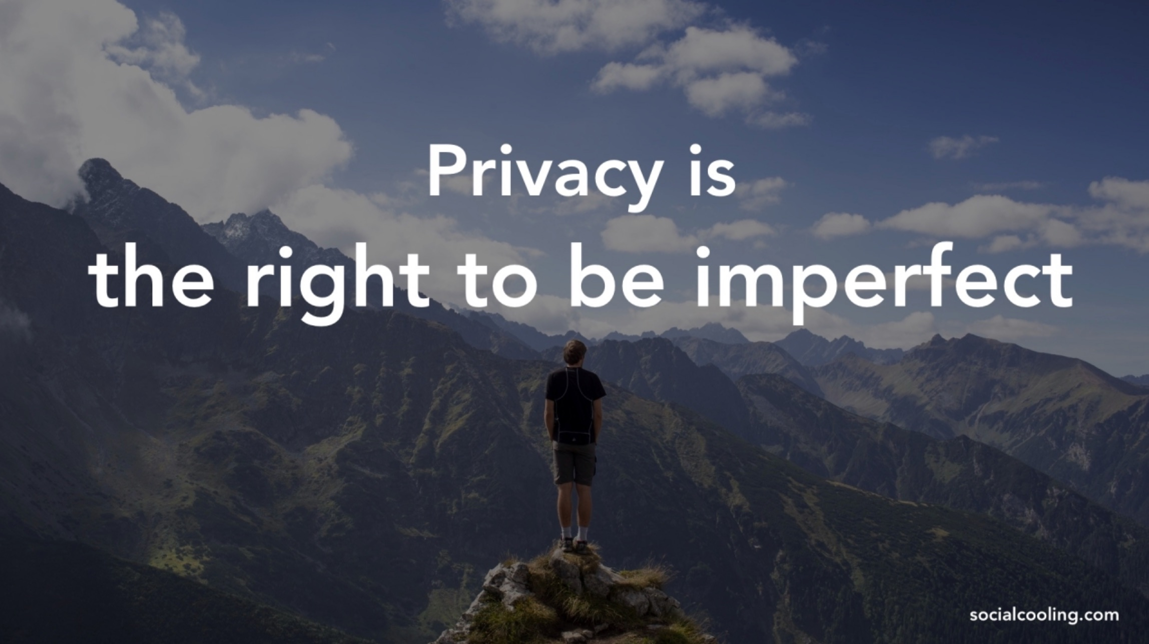

Slide 52
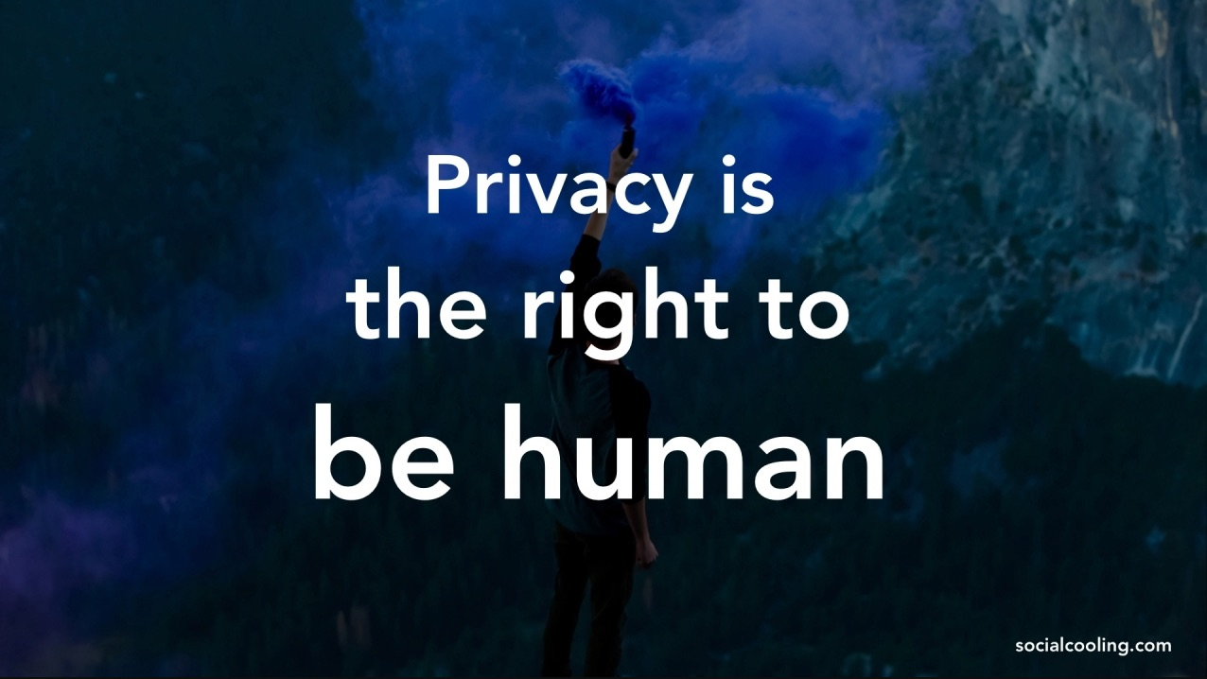

Slide 53
References
Title Slide - Figure: ‘New World Order’ - Alexander Hayes, 2019
Slide 2 - Invited Speaker - http://www.alexanderhayes.com
Slide 3 - Acknowledgement of Country - http://www.noongar.org.au/noongar-protocols Slide 4 - Consent
Slide 5 - The Socioethical Implications of Body Computers: An Ethnographic Study’ - https://www.alexanderhayes.com/journal/phd-research-summary
Slide 6 - Benefit | Detriment
Slide 7 - Humanity ( Icon: https://www.freepik.com/ )
Slide 8 - ‘U’ Are The Product - Figure: ‘New World Order’ - Alexander Hayes, 2019
Slide 9 - Parameters - Figure: ‘New World Order’ - Alexander Hayes, 2019

Slide 54
References
Slide 10 - ‘Surveillance’ - Figure: ‘New World Order’ - Alexander Hayes, 2019
Slide 11 - David Lyons - https://www.youtube.com/watch?v=kWPOyuoF7oA&
Slide 12 - ‘Sousveillance’ - Figure: ‘New World Order’ - Alexander Hayes, 2019
Slide 13 - Steve Mann - https://spectrum.ieee.org/geek-life/profiles/steve-mann-my-augmediated-life
Slide 14 - Steve Mann - TEDxUTSC - https://youtu.be/Z9qiWqRPrcw
Slide 15 - Gordon Bell: https://en.wikipedia.org/wiki/Gordon_Bell#/media/File:Gordon_Bell.jpg
Slide 16 - IEEE ISTAS’13 Conference Website - http://sites.ieee.org/istas-2013/
Slide 17 - ‘Dataveillance’ - Figure: ‘New World Order’ - Alexander Hayes, 2019

Slide 55
References
Slide 18 - ‘Dataveillance’ - http://www.rogerclarke.com/DV/DVR.html
Slide 19 - ‘Care, Convenience, Control’ - Figure: ‘New World Order’ - Alexander Hayes, 2019
Slide 20 - Katina Michael - ‘Care, Convenience, Control’ - http://dx.doi.org/10.1109/WMCS.2005.11
Slide 21 - ‘Uberveillance’ - Figure: ‘New World Order’ - Alexander Hayes, 2019
Slide 22 - ‘Uberveillance’ - M.G. Michael - http://uberveillance.com/definition
Slide 23 - RFID Implant - Photo: https://bit.ly/2Xc6LjV
Slide 24 - Biohacking - https://www.biohax.tech/
Slide 25 - Uberveillance - ‘Themes’ - http://uberveillance.com/themes

Slide 56
References
Slide 26 - ‘Corporations, Government, Public’ - Figure: ‘New World Order’ - Alexander Hayes, 2019
Slide 27 - Case Study 1 - ‘Right To Pass’ - 142 High Street, Fremantle, Western Australia
Slide 28 - Case Study 1 - ‘Right To Pass: Map’ - 142 High Street, Fremantle, Western Australia
Slide 29 - Case Study 1 - ‘Right To Pass: Photos’ - 142 High Street, Fremantle, Western Australia
Slide 30 - Case Study 2 - ‘Perth City Watch’ - Perth, Western Australia
Slide 31 - Case Study 2 - ‘Perth City Watch: Map’ - Perth, Western Australia
Slide 32 - Case Study 2 - ‘Perth City Watch: Satellite’ - Perth, Western Australia
Slide 33 - Perth City Council Facial Recognition Cameras - https://www.abc.net.au/news/2019-06-08/city-of-perth-rolls-out-new-facial-recognition-cctv-cameras/11147780

Slide 57
References
Slide 34 - Perth City Council Facial Recognition Cameras - https://www.theguardian.com/technology/2019/jun/12/perth-councils-facial-recognition-trial-accused-of-blanket-surveillance
Slide 35 - Citywatch - https://www.abc.net.au/news/2019-06-08/officer-monitors-citywatch-cctv-surveillance-cameras-1/11191026
Slide 36 - Case Study 3 - ‘Body Worn Cameras’ - Perth, Western Australia
Slide 37 - Perth City Council - https://www.heraldsun.com.au/news/national/perth-parking-inspectors-fitted-with-body-cameras/news-story/36ee278fd66dcfa8fb103d90e1ec2628
Slide 38 - WA Government - https://www.mediastatements.wa.gov.au/Pages/McGowan/2019/03/Body-worn-cameras-to-be-deployed-to-frontline-officers.aspx
Slide 39 - City of Perth - ‘Page missing’ - https://www.perth.wa.gov.au/newsroom/featured-news/body-cameras-promote-safer-community

Slide 58
References
Slide 40 - Email Correspondence - Kylie Taylor, Perth City Council
Slide 41 - The West - https://thewest.com.au/news/crime/commissioner-acts-to-give-wa-police-body-worn-cameras-ng-b88921149z
Slide 42 - Life Inside China’s Total Surveillance State - https://youtu.be/OQ5LnY21Hgc
Slide 43 - China’s Social Credit System - https://www.abc.net.au/news/2018-03-31/chinas-social-credit-system-punishes-untrustworthy-citizens/9596204
Slide 44 - ‘Your Data’ - http://www.socialcooling.com
Slide 45 - ‘Their Data’ - http://www.socialcooling.com
Slide 46 - ‘Nothing To Hide’ - https://en.wikipedia.org/wiki/Nothing_to_hide_argument - https://en.wikipedia.org/wiki/Eric_Schmidt#/media/File:Eric_Schmidt_at_the_37th_G8_Summit_in_Deauville_037.jpg

Slide 59
References
Slide 47 - ‘Nothing To Hide’ - https://en.wikipedia.org/wiki/Nothing_to_hide_argument
Slide 48 - ‘Digital Rights Watch’ - https://digitalrightswatch.org.au/
Slide 49 - ‘EFF’ - https://www.eff.org/
Slide 50 - ‘ APF’ - http://www.privacy.org.au
Slide 51 - ‘Privacy Is The Right To Be Imperfect’ - http://www.socialcooling.com
Slide 52 - ‘Privacy Is The Right To Be Human’ - http://www.socialcooling.com

