Slide 1
Power & Surveillance
SAE Creative Institute, Perth, Western Australia
23rd October 2019

Slide 2
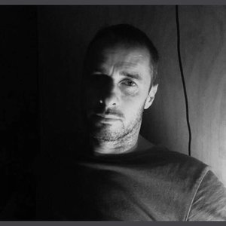
ALEXANDER HAYES
PhD candidate University of Wollongong, Sydney Australia Visiting Researcher Aalto University, Helsinki, Finland

Slide 3
Acknowledgement of Country
Alexander Hayes acknowledges that this presentation occurred on the Country of the Whadjuk People of the Noongar / Nyungar Nation in Perth, Western Australia. Alexander wishes to acknowledge past, present and future leaders of the Whadjuk People and respect their continuing culture and the contribution they make to the life of this city and this region.

Slide 4
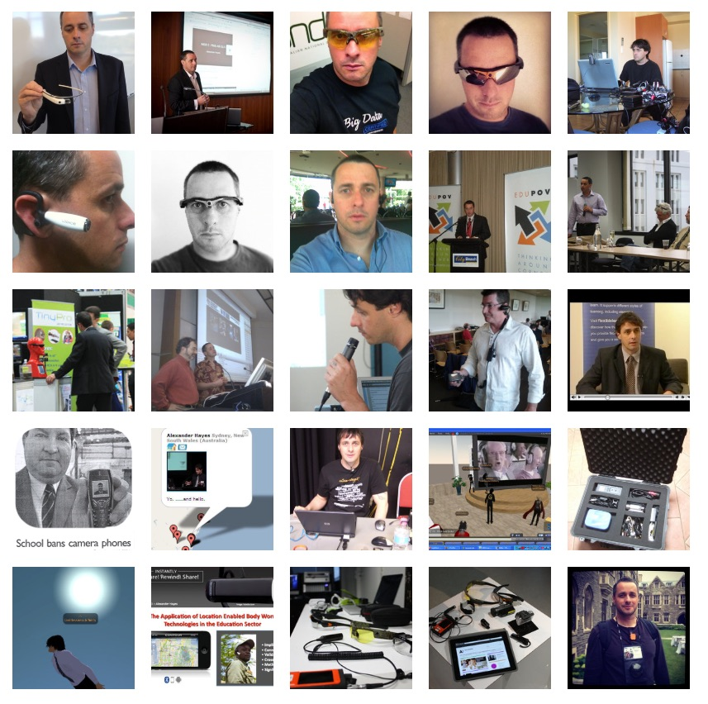
‘The Socioethical Implications of Body Worn Computers: An Ethnographic Study’
- 50 interviews with international leaders - engineering, policing, surveillance studies, national security, cyber-crimes, information systems, education and human computing industry.
privacy, security, society, implications, control, power, place, care, convenience, engineering, corporations, law, regulation, innovation, veillance, wearable computing

Slide 6
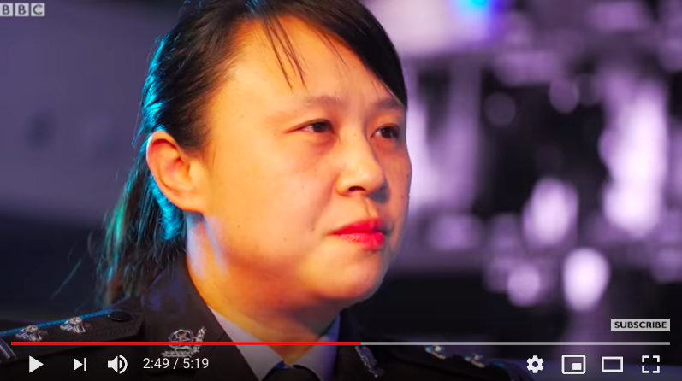

Slide 7
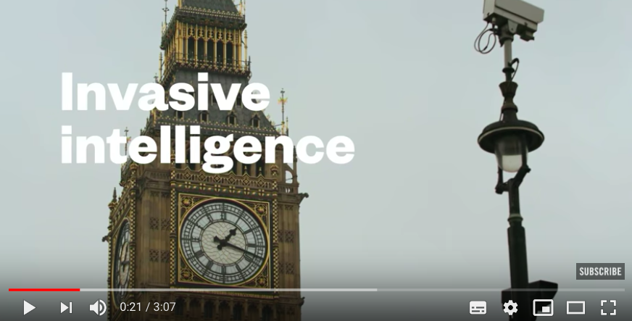

Slide 8
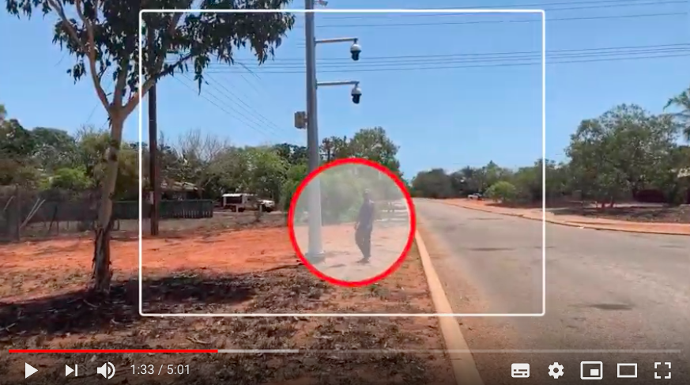
ALL UNDER ONE CCTV

Slide 9
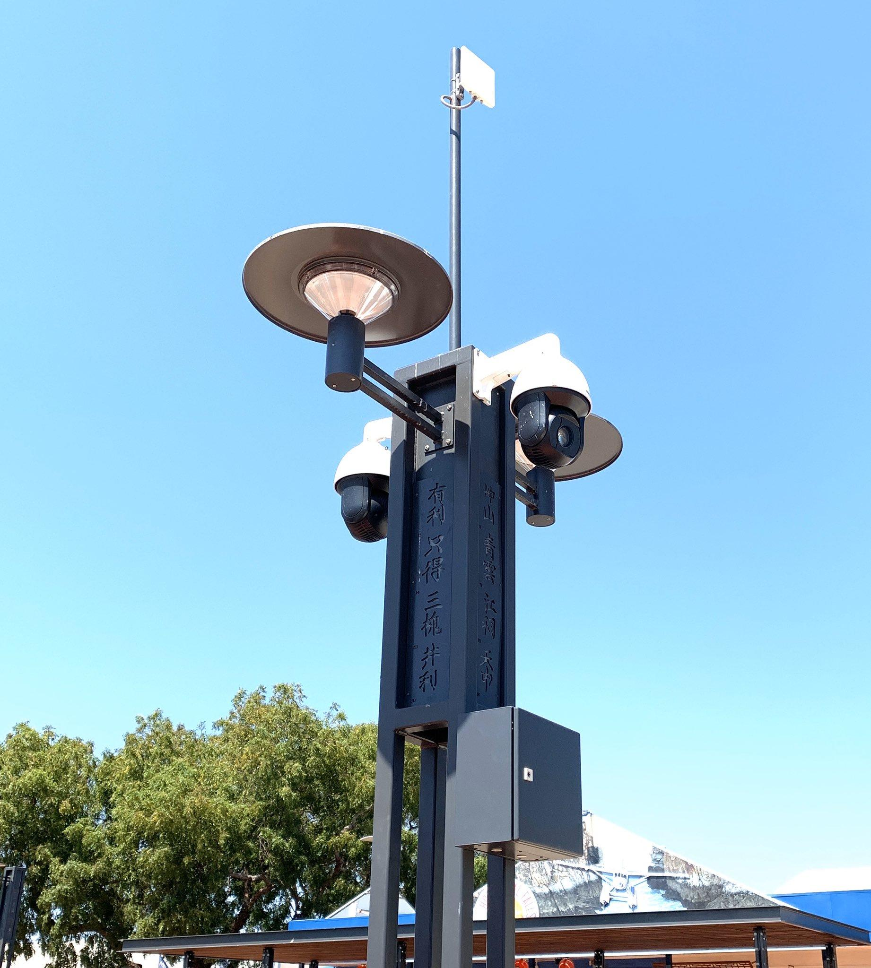
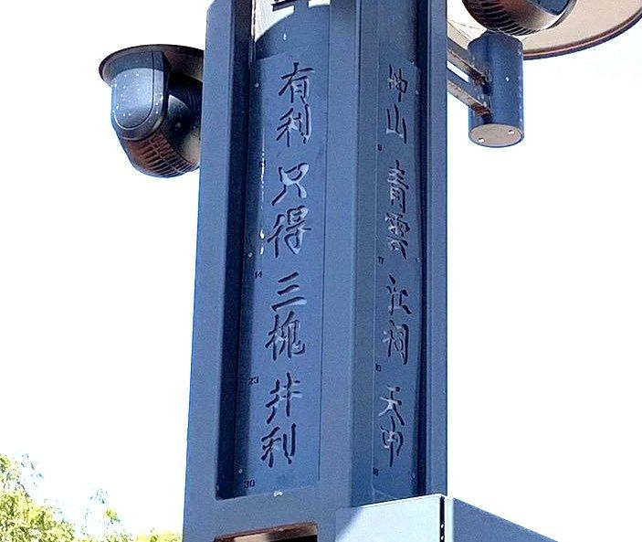
Broome, Western Australia
Tuesday 22nd October 2019

Slide 10
Case Study 2 ‘Perth City Watch’
Perth, Western Australia

Slide 11
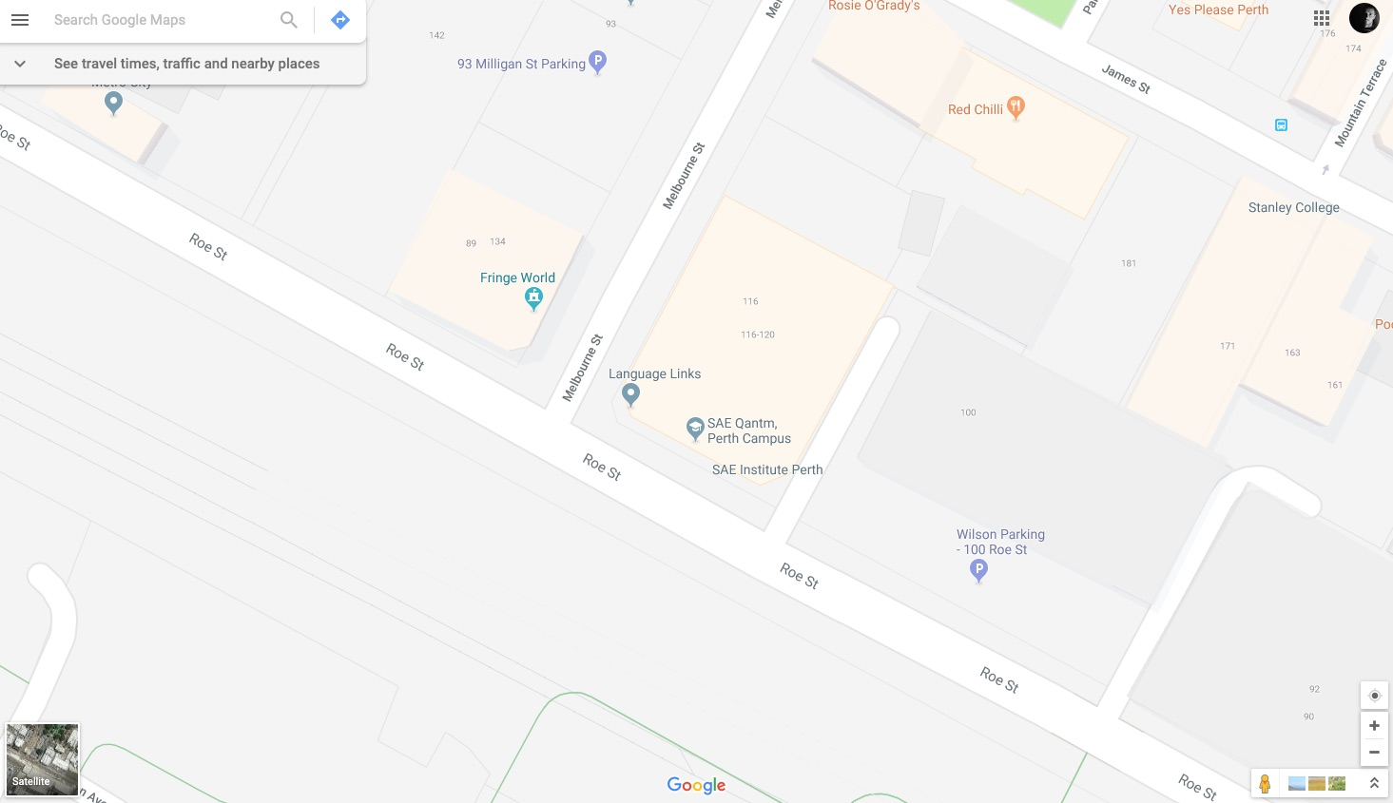

Slide 12
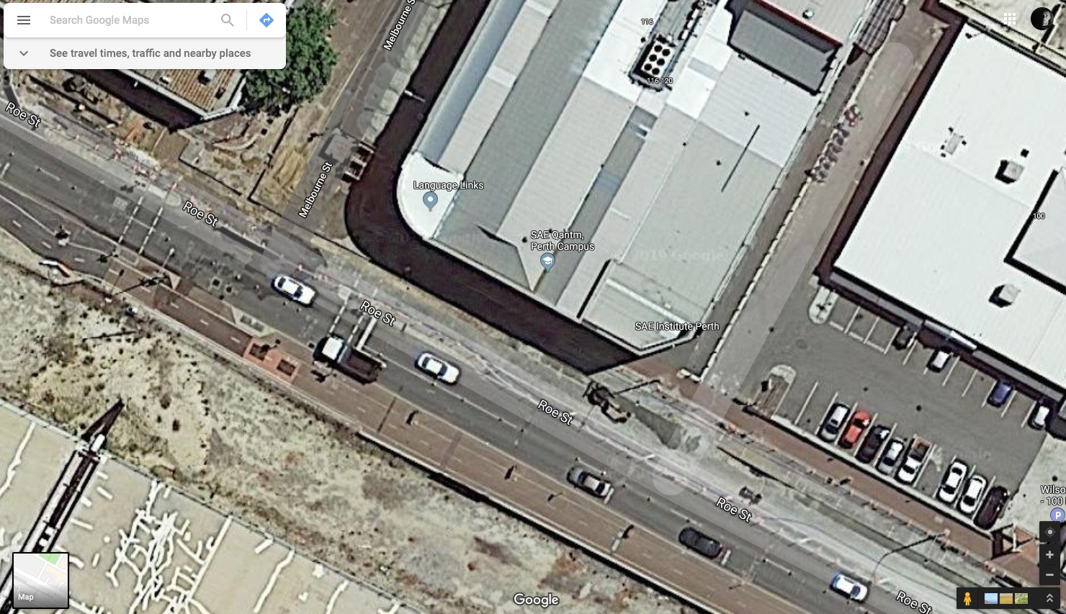

Slide 13
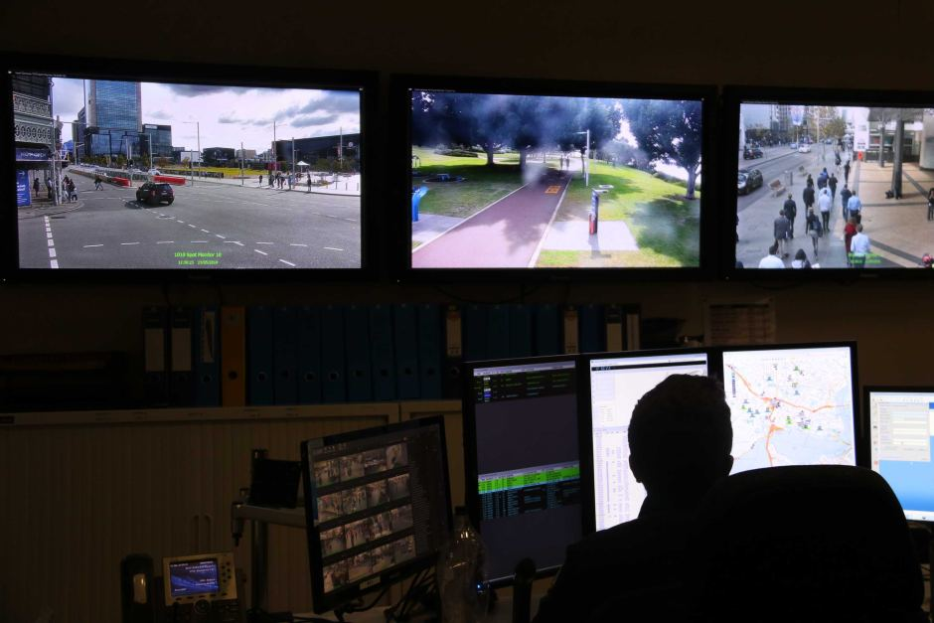
https://www.abc.net.au/news/2019-06-08/officer-monitors-citywatch-cctv-surveillance-cameras-1/11191026

Slide 14
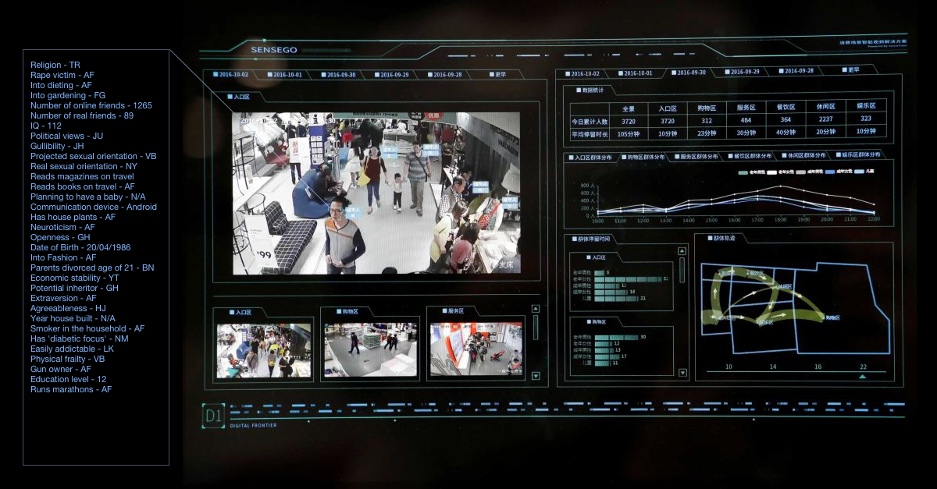

Slide 15
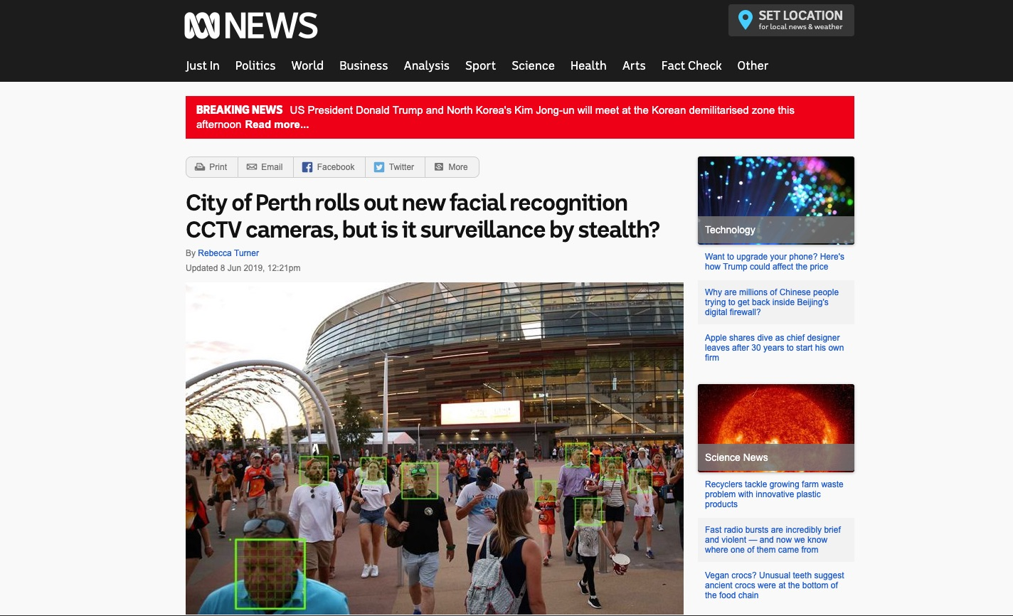
https://www.abc.net.au/news/2019-06-08/city-of-perth-rolls-out-new-facial-recognition-cctv-cameras/11147780

Slide 16
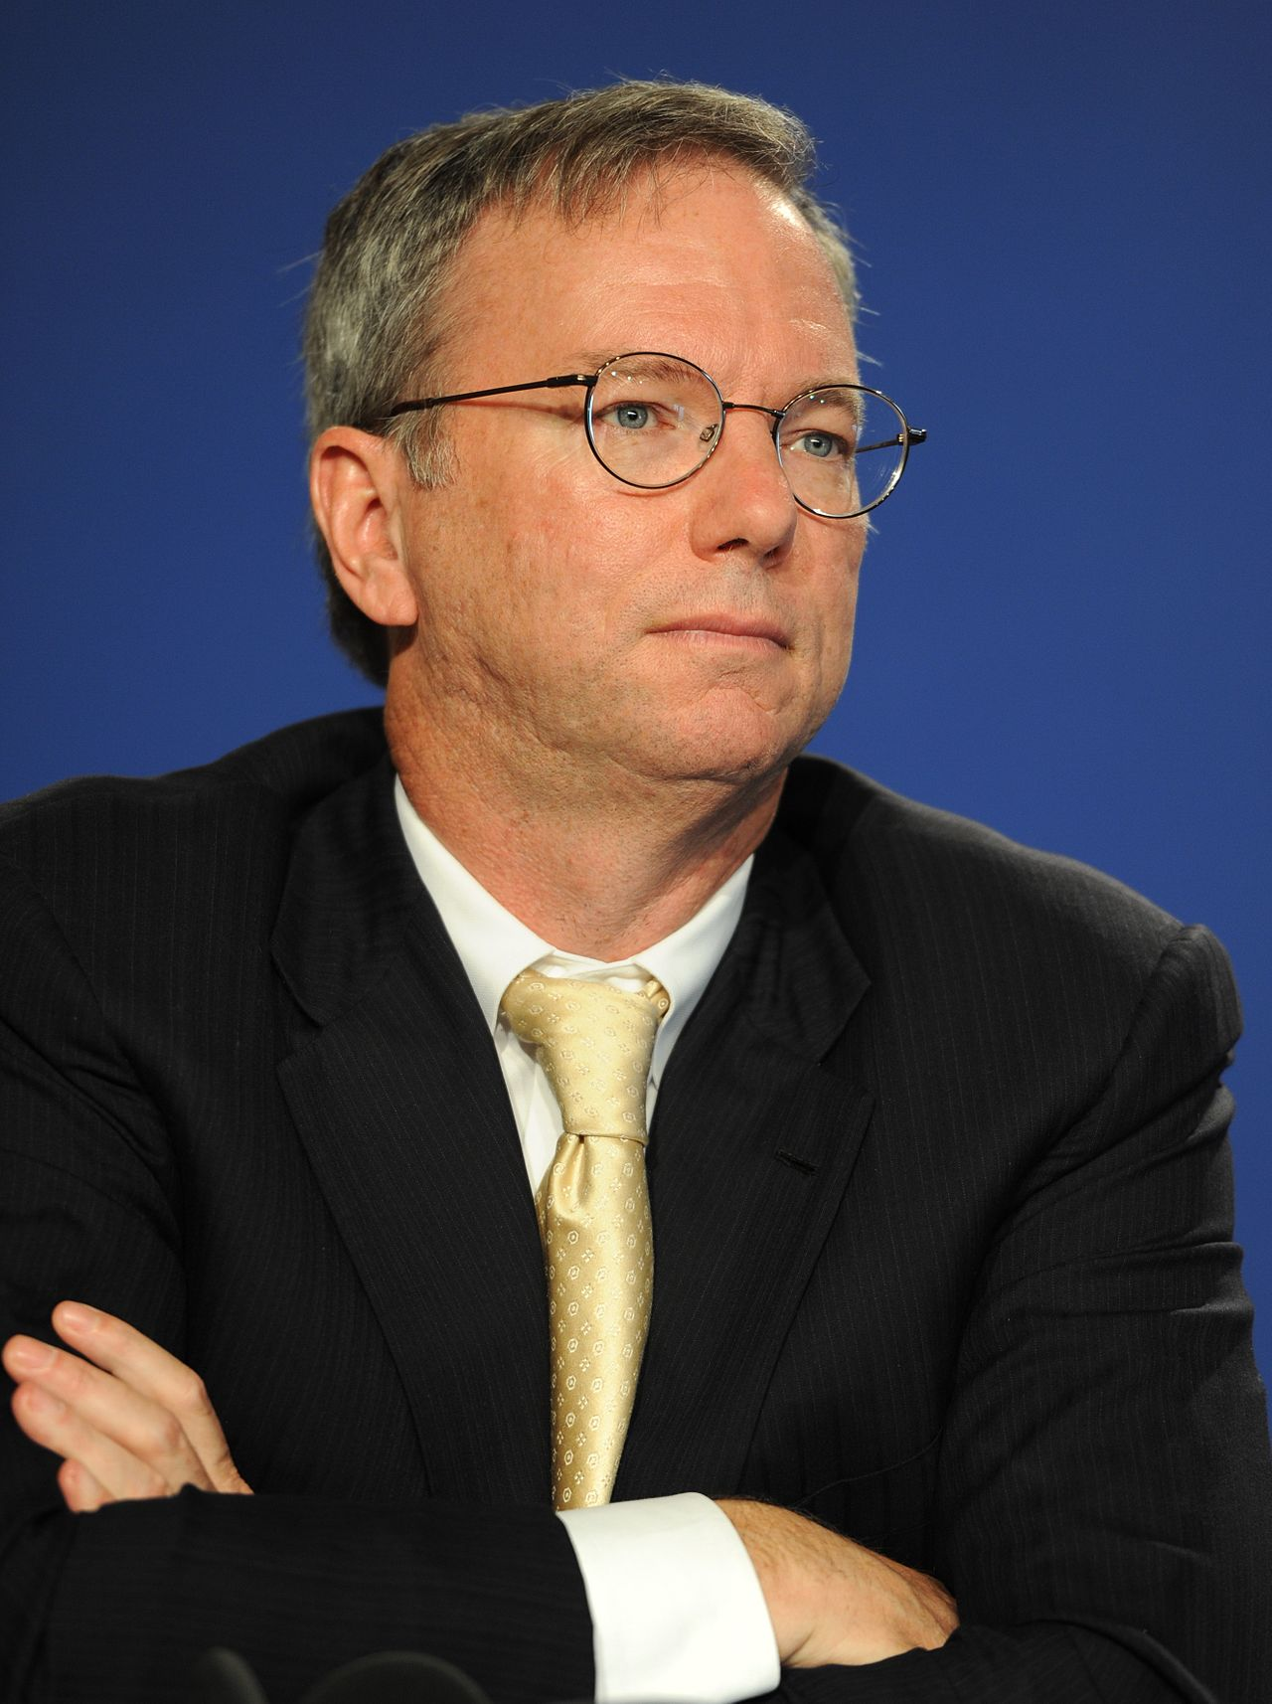
"... If you have something that you don't want anyone to know, maybe you shouldn't be doing it in the first place, but if you really need that kind of privacy, the reality is that search engines including Google do retain this information for some time, and it's important, for example that we are all subject in the United States to the Patriot Act. It is possible that that information could be made available to the authorities.”
Eric Schmidt - Former CEO, Google Inc.

Slide 17
DO YOU HAVE ANYTHING TO HIDE?
What would be the ramifications of every single search term you had used in the last two years was made public?
Would it matter if your sexual health records, sexual preferences and your dating behaviours were made accessible to your entire Family, social networks and every person on your contact address book?

Slide 18
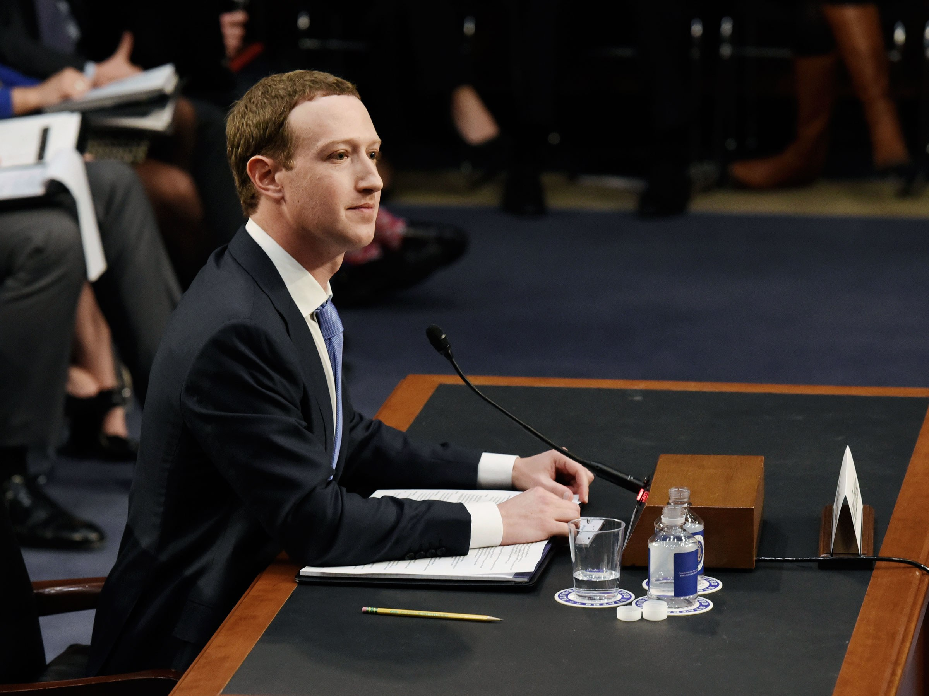
“We believe that for the future, people want a privacy-focused social platform. I believe that if we build out a fully encrypted interoperable service… that's going to be an important contribution to the world. “This is about building the kind of future we want to live in,” he added. - Apr 30, 2019
Mark Zuckerberg - Facebook

Slide 19
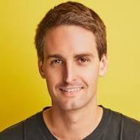
“...Snapchat CEO Evan Spiegel said that some of his earliest decisions at the company helped position the company in today's social media climate - like his hard line on privacy and focusing the app on the camera instead of a feed like Facebook.”
Evan Spiegel - Snapchat

Slide 20
“...Zhang has now pledged that Bytedance will increase its team of censors from six thousand to ten thousand, create a blacklist of banned users, and develop better technology to monitor and screen content.”
Zhang Yiming - Bytedance

Slide 21
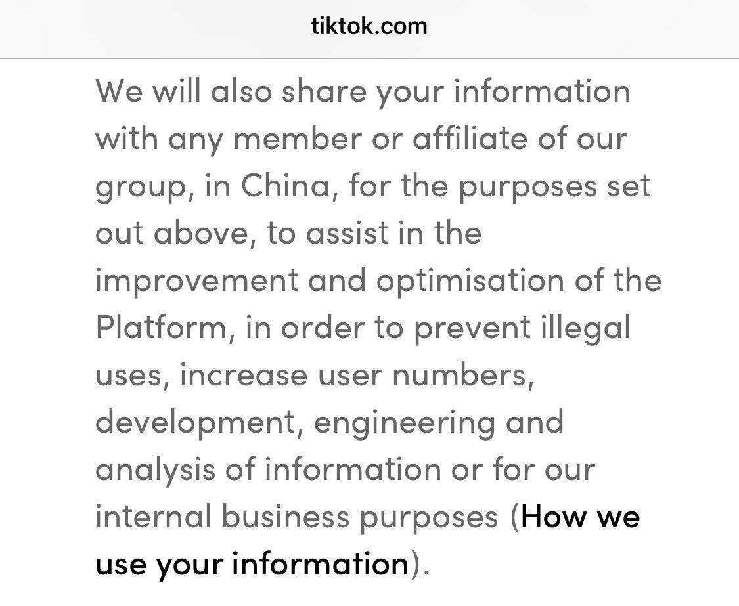

Slide 22
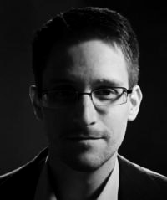
“... Arguing that you don't care about the right to privacy because you have nothing to hide is no different than saying you don't care about free speech because you have nothing to say."
Edward Snowden

Slide 23
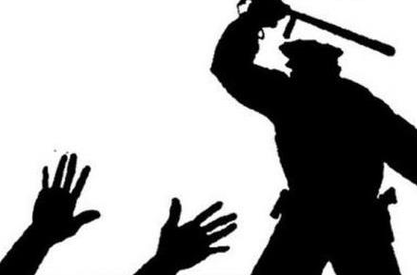
‘... DO AS YOU ARE TOLD, OBEY AND FOLLOW THROUGH ON EVERYTHING THAT YOU ARE INSTRUCTED TO BE, DO NOT THINK, YOU ARE NOT A PERSON YOU ARE A NUMBER, YOUR POINT OF VIEW DOES NOT COUNT ONLY THE SUPREME LEADER IS PERMITTED TO THINK, THERE IS NO PRIVACY ONLY TRANSPARENCY, SILENCE IS THE BEST WAY AT ALL TIMES.’
SHUT UP

Slide 24
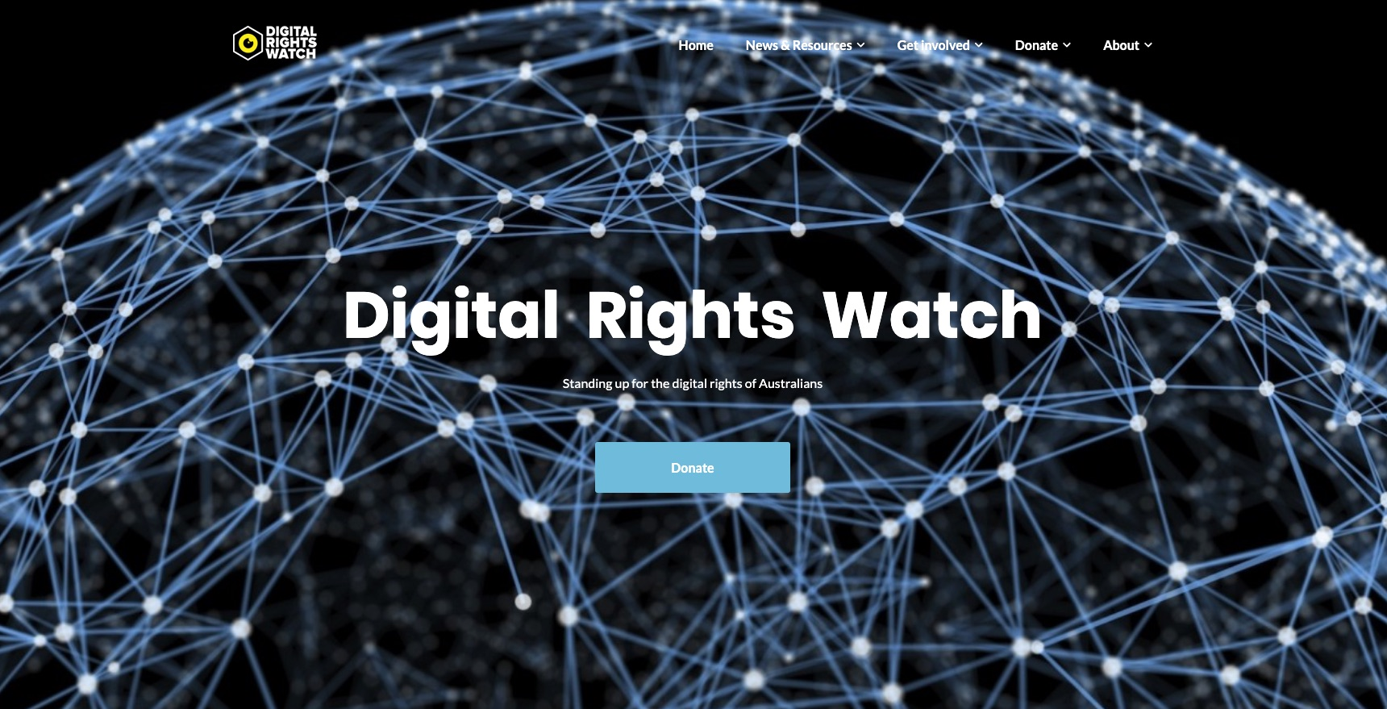

Slide 25
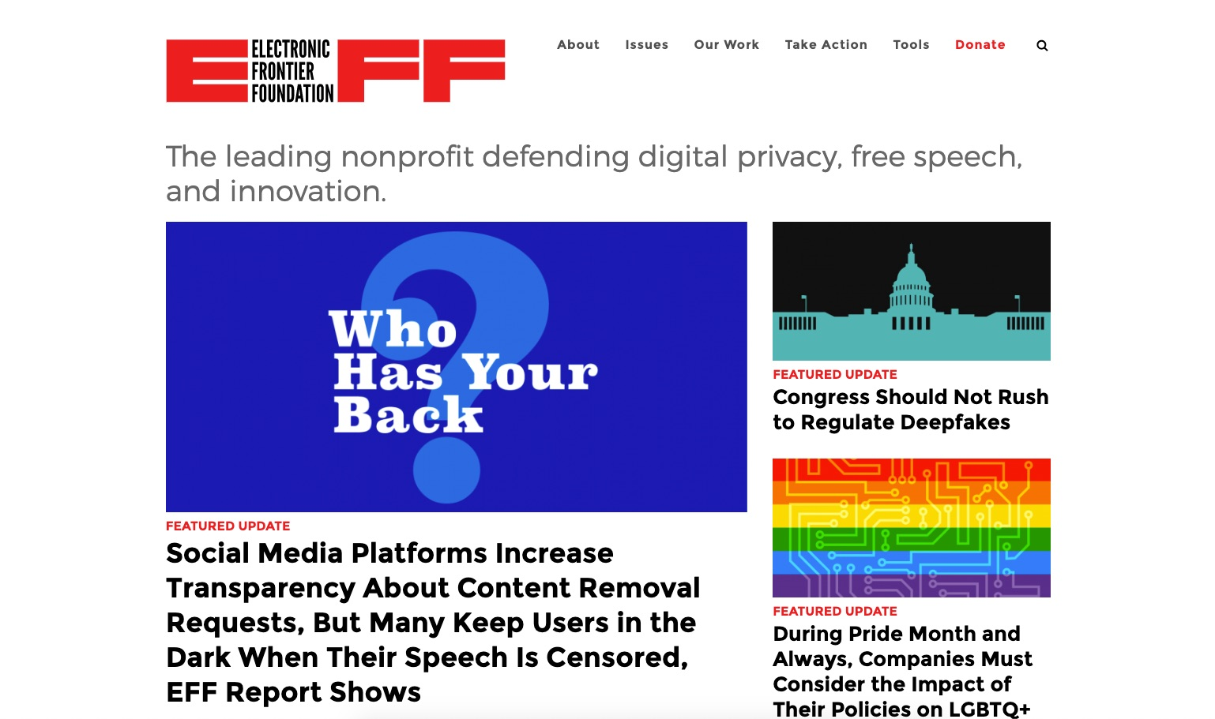

Slide 26
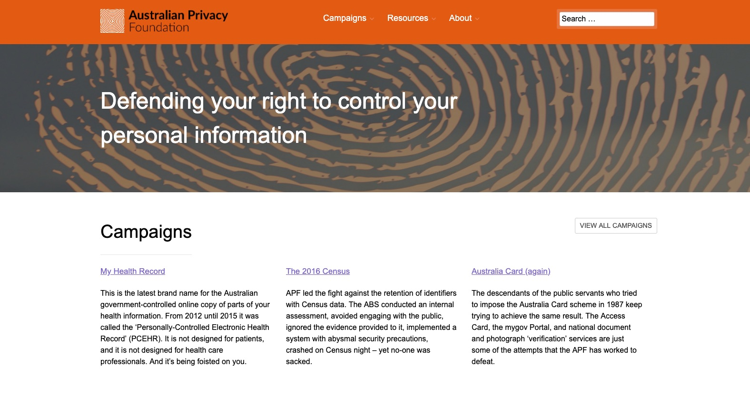

Slide 27
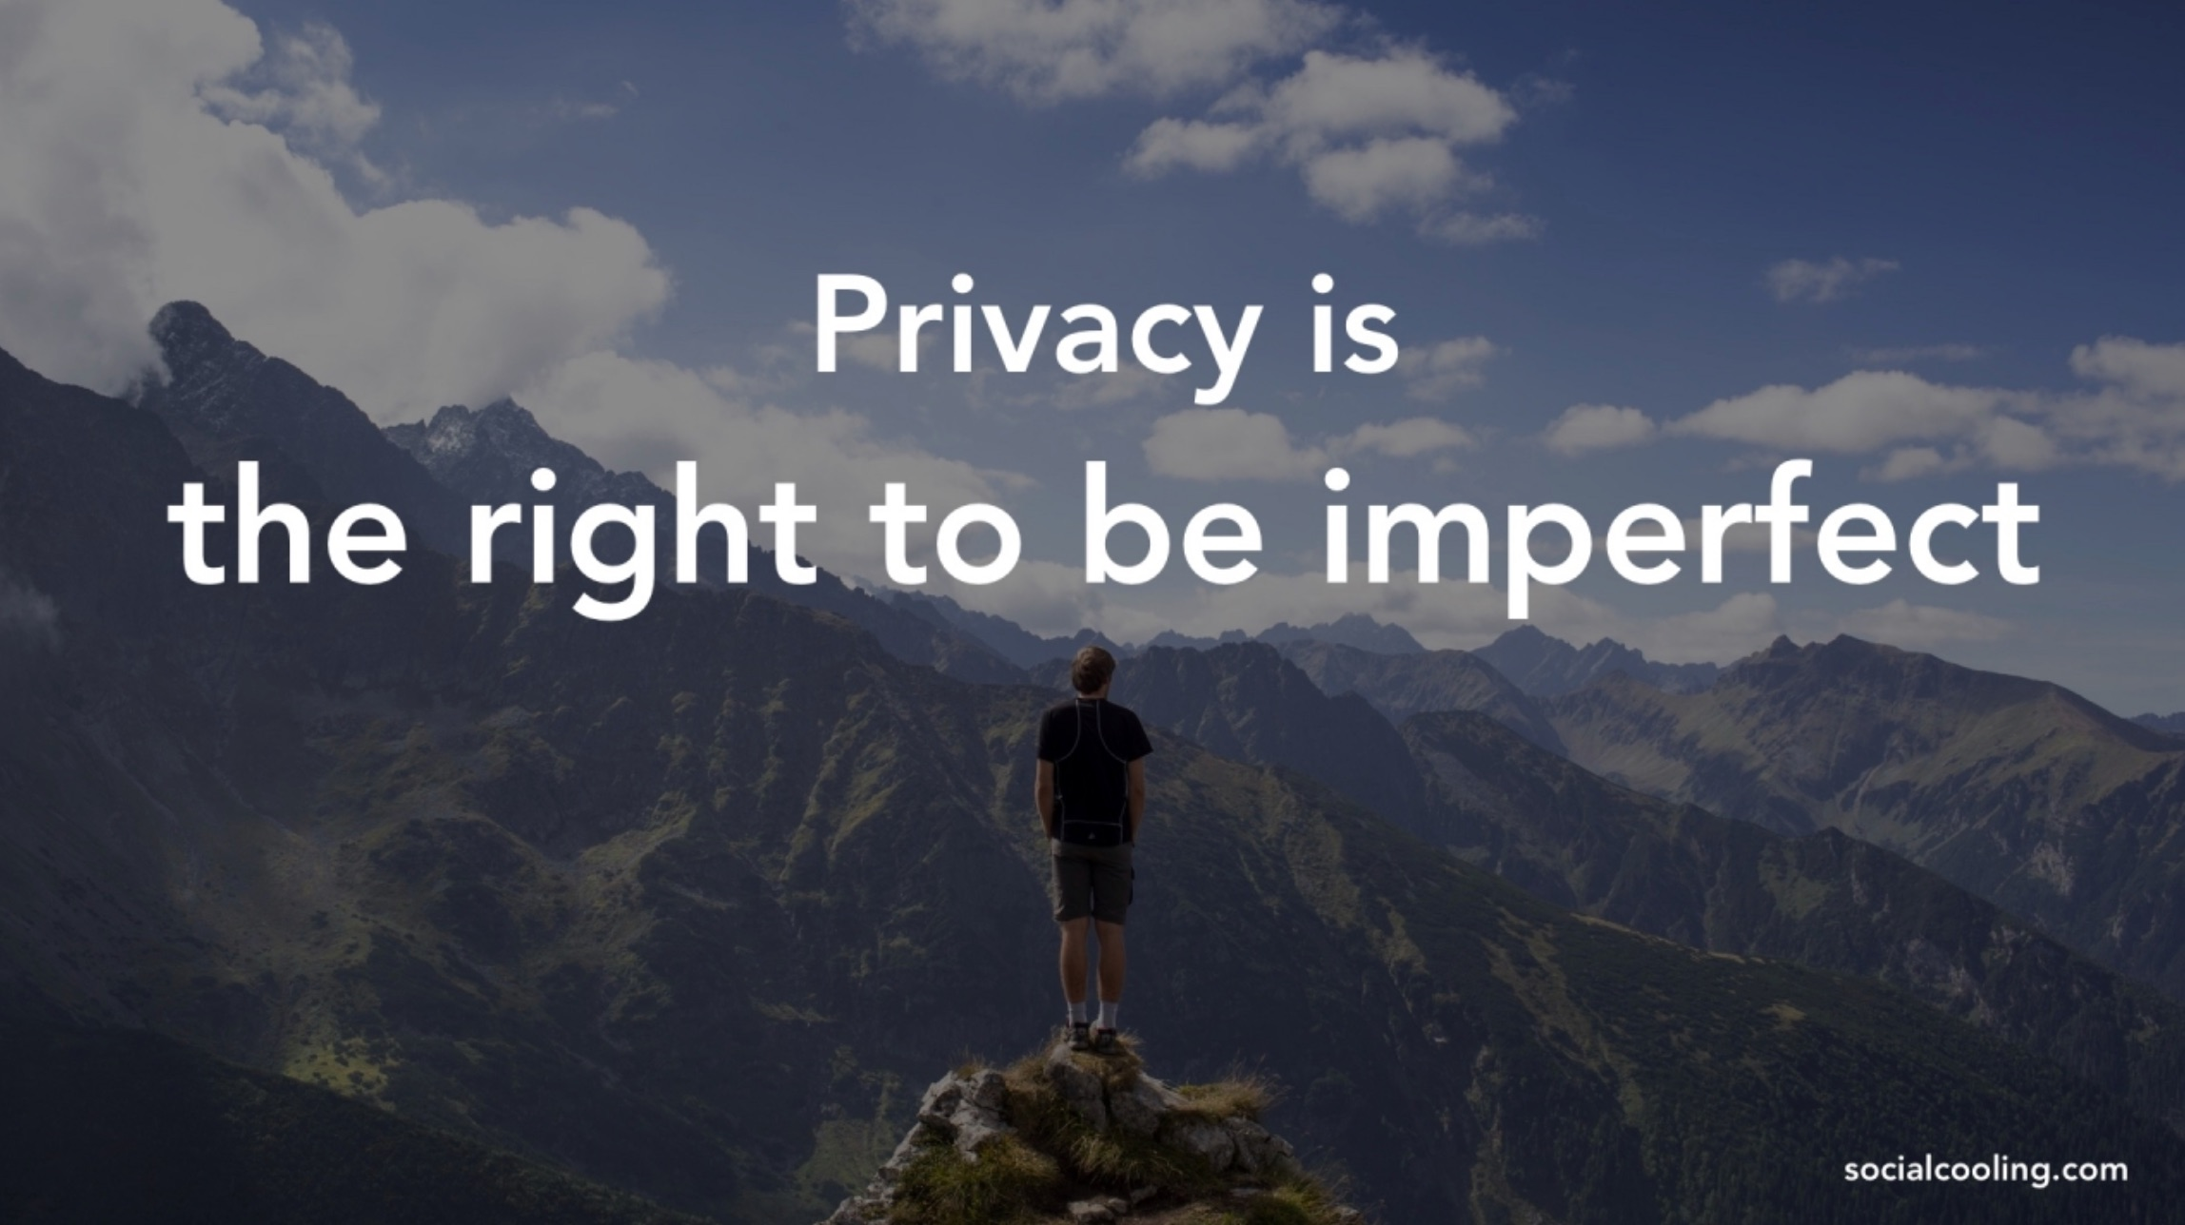

Slide 28
